Slide 1
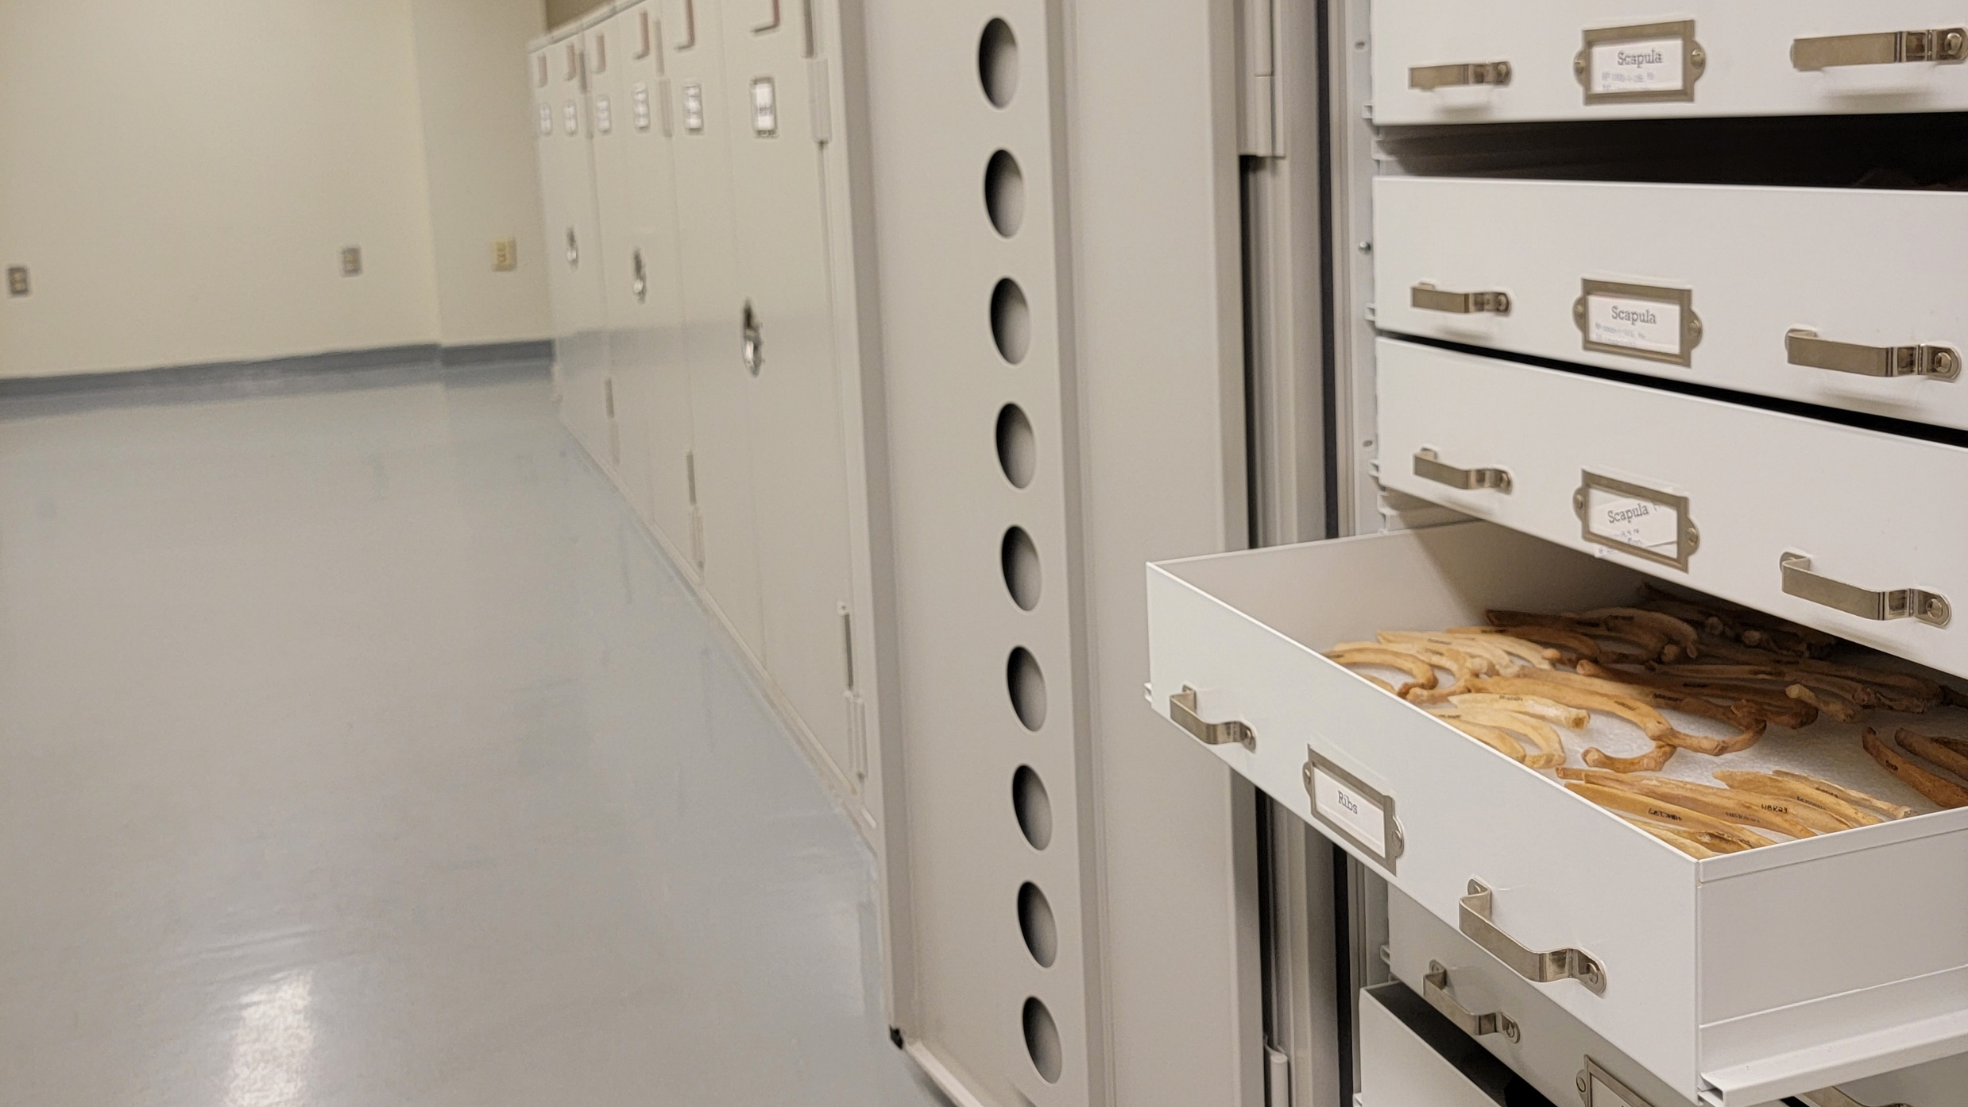
Analysis and Quantification of Commingled Human Skeletal Remains in Syracuse University’s Historic Medical Teaching Collection Using the CoRA Ecosystem
By Madeline Kelly

Slide 2
Outline
Background
Project Goals
Methods and the Commingled Remains Analytics (CoRA) ecosystem
Results
Future Directions and additional applications of CoRA
Conclusion

Slide 3
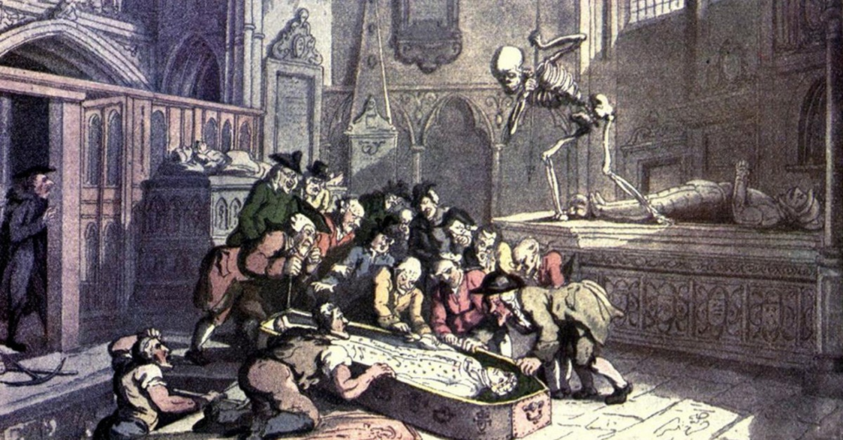
Background

Slide 4
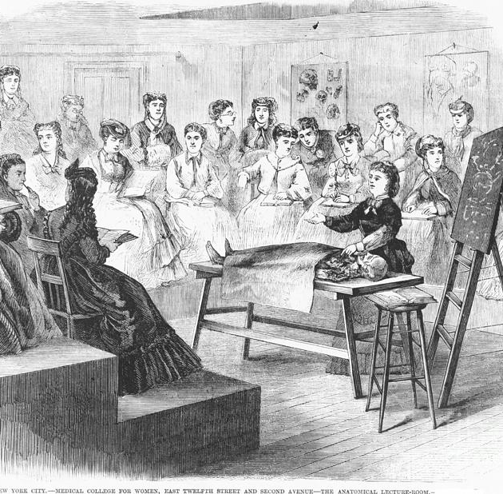
Anatomical Era
Beginning in the late 18th and early 19th century¹
Textbooks/ lectures → Dissections and anatomical demonstrations^{1,2}
Increase in the need for human cadavers^{1,2}
Disproportionately affected immigrant groups, minorities, and the poor¹

Slide 5
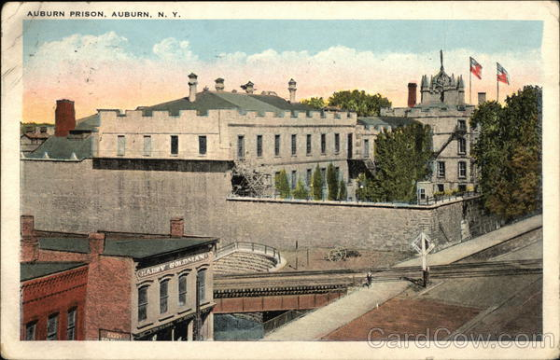
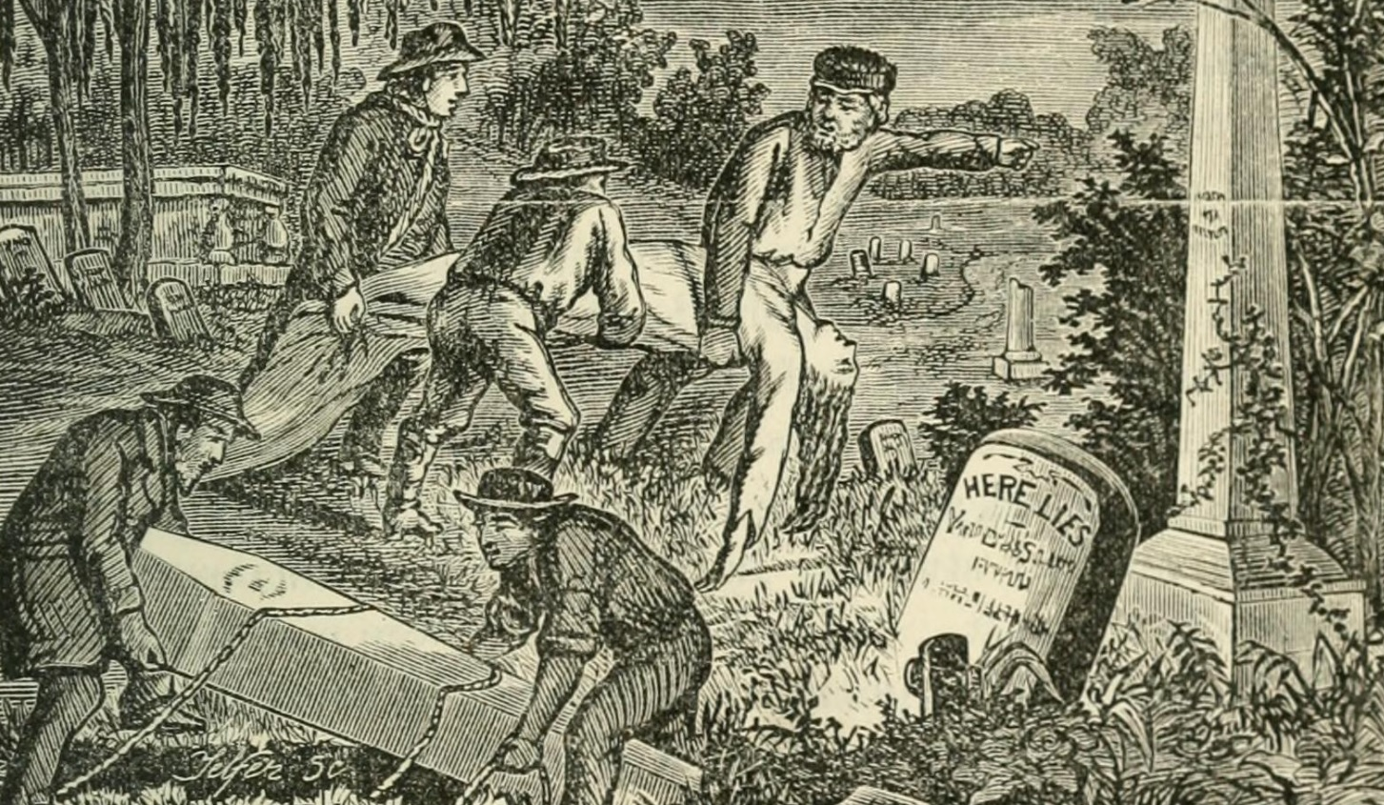
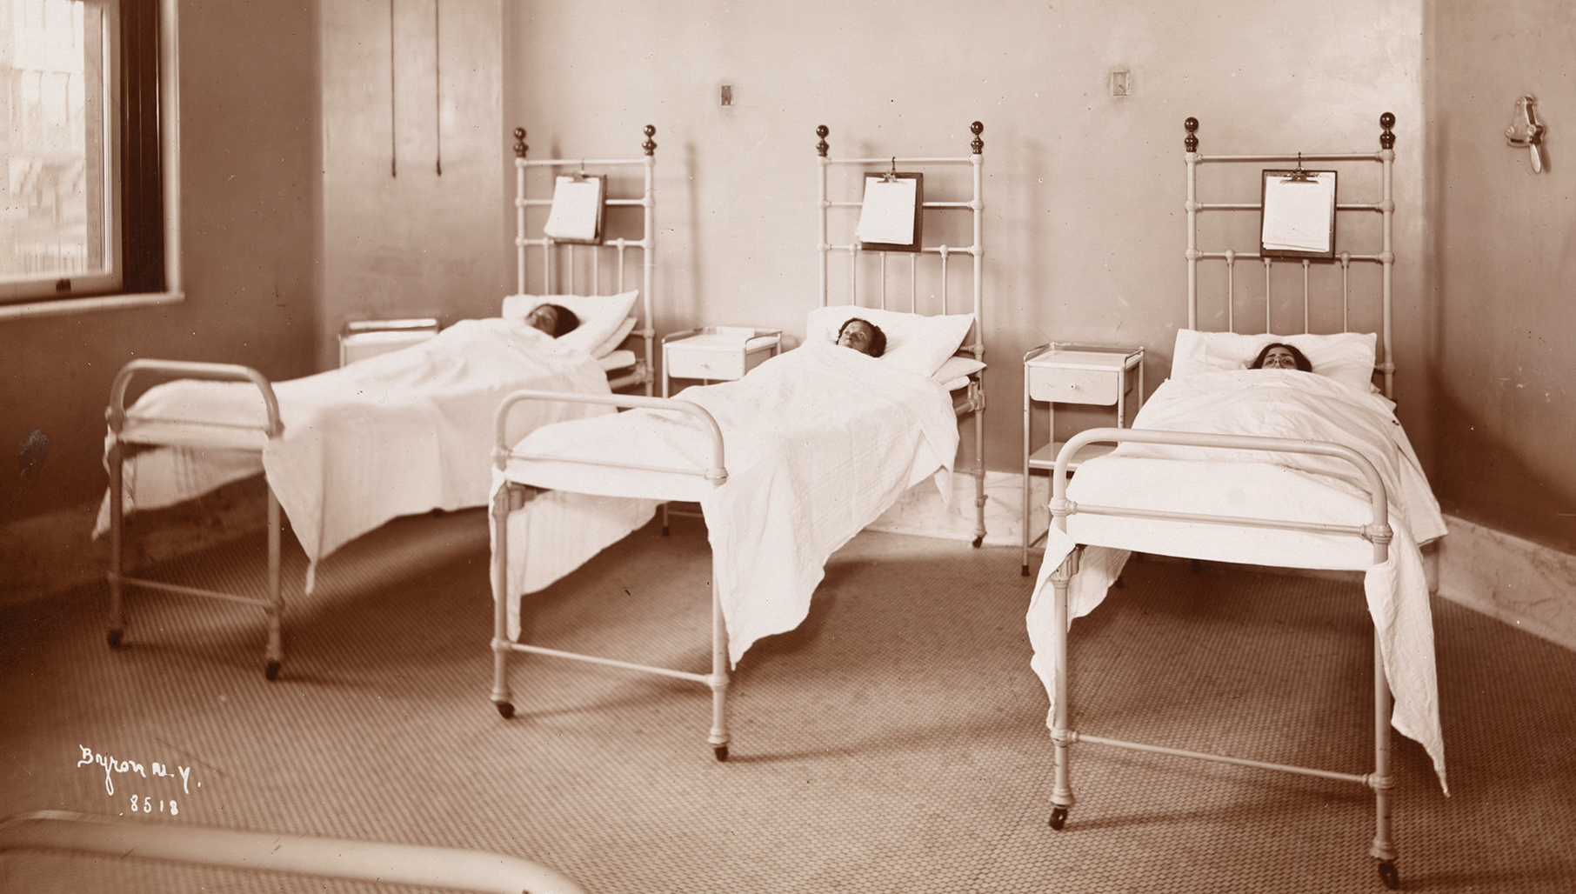
Prisons
“Body-snatching”
Unclaimed Persons

Slide 6
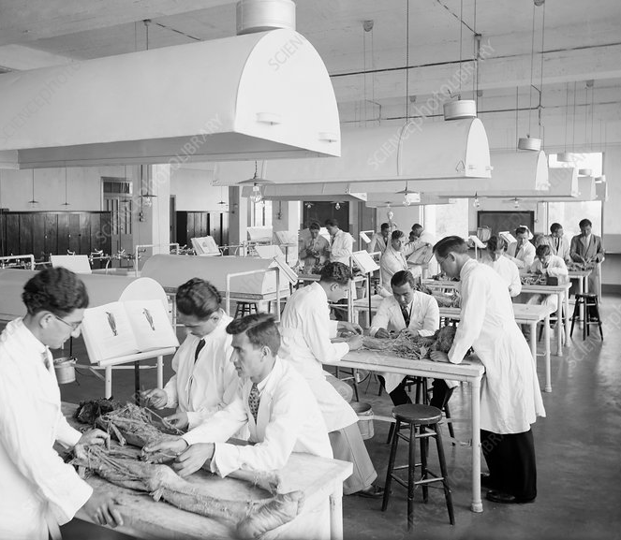
Prisons
“Body-snatching”
Dissections/ Anatomical Demonstrations
Unclaimed Persons

Slide 7
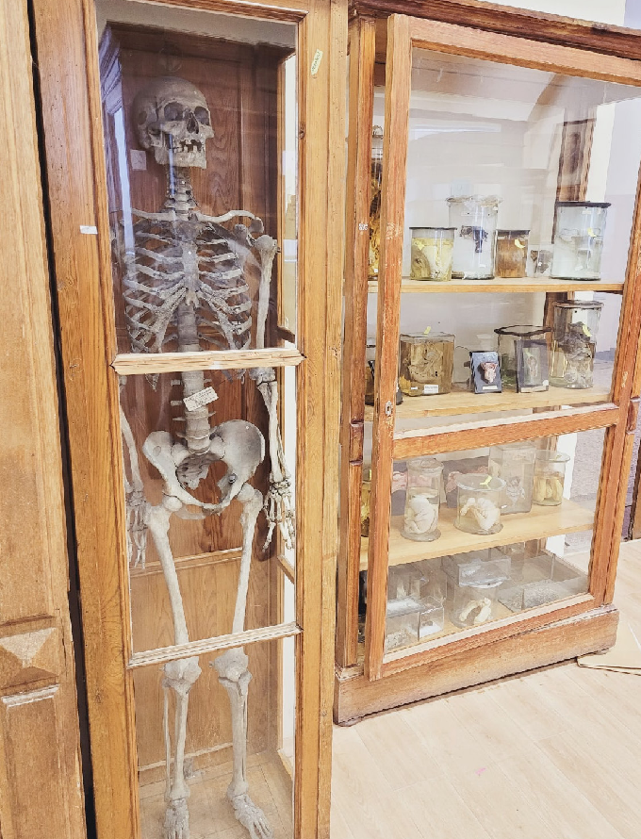
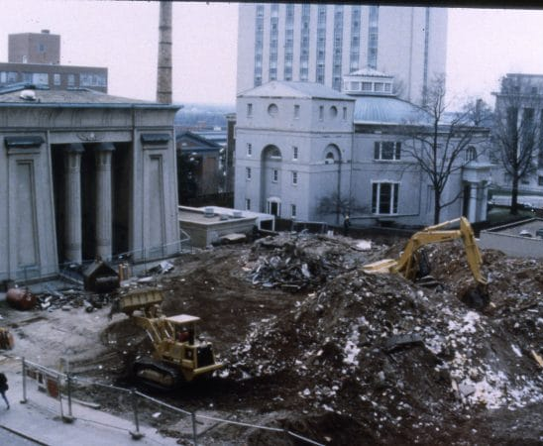
Prisons
Osteological Collections
“Body-snatching”
Dissections/ Anatomical Demonstrations
Disposal
Unclaimed Persons

Slide 8
Directly to cleaning/processing
Prisons
Osteological Collections
“Body-snatching”
Dissections/ Anatomical Demonstrations
Disposal
Unclaimed Persons

Slide 9
Directly to cleaning/processing
Prisons
Osteological Collections
“Body-snatching”
Dissections/ Anatomical Demonstrations
Disposal
Unclaimed Persons

Slide 10

Osteological Collections

Slide 11
Syracuse University’s Medical Teaching Collection - History
What we know
> Previous and subsequent schools associated with Syracuse University
What we don’t know
> Age of the collection/ length of accumulation
> Method of procurement
> Fate of the Gevena College Anatomical Museum
> Anatomy courses and dissection opportunities
> Archival material – exhumation, cadaver trade, Auburn prison

Slide 12
Syracuse University’s Medical Teaching Collection - Contents
What we know
> Mainly adult human skeletal remains with some sub-adult specimens
What we don’t know
> Number of individuals
> Mostly commingled and sorted by element and side
> Information associated with biological profiles (age, sex, ancestry, stature)
> Age of remains/ where they were obtained from
> Trauma, pathology, taphonomy, anomalies, etc?

Slide 13
Project goals
Is there evidence to support the theory that these remains were part of a medical/ anatomical teaching collection?
How many individuals are present in this collection?
Can CoRA be used as a valuable database and data analysis tool for documenting and analyzing anatomical and medical teaching collections of skeletal remains?

Slide 14
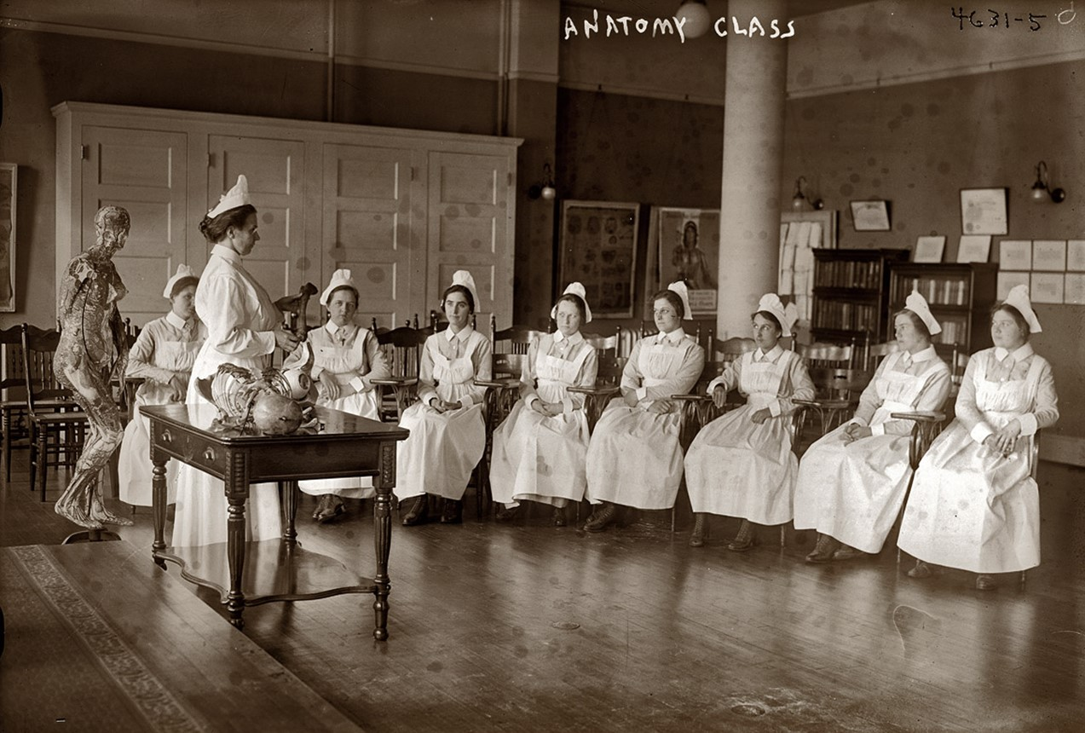
Materials and Methods

Slide 15


What is CoRA?
Commingled Remains Analytics (CoRA) – web application, database, and Application Programming Interface³
Created by Dr. Sachin Pawaskar, University of Nebraska Omaha
Developed specifically for inventorying and analyzing assemblages of commingled human remains³

Slide 16
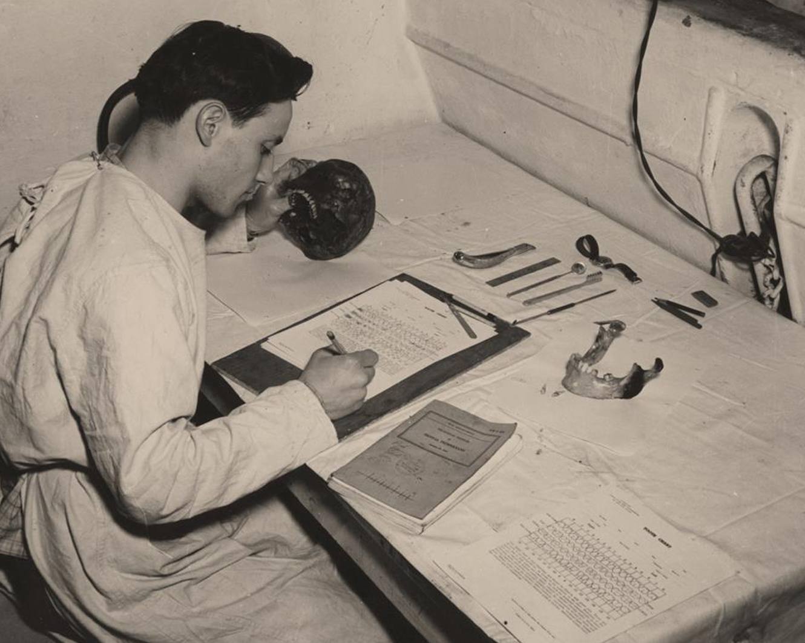
Why CoRA?

Slide 17
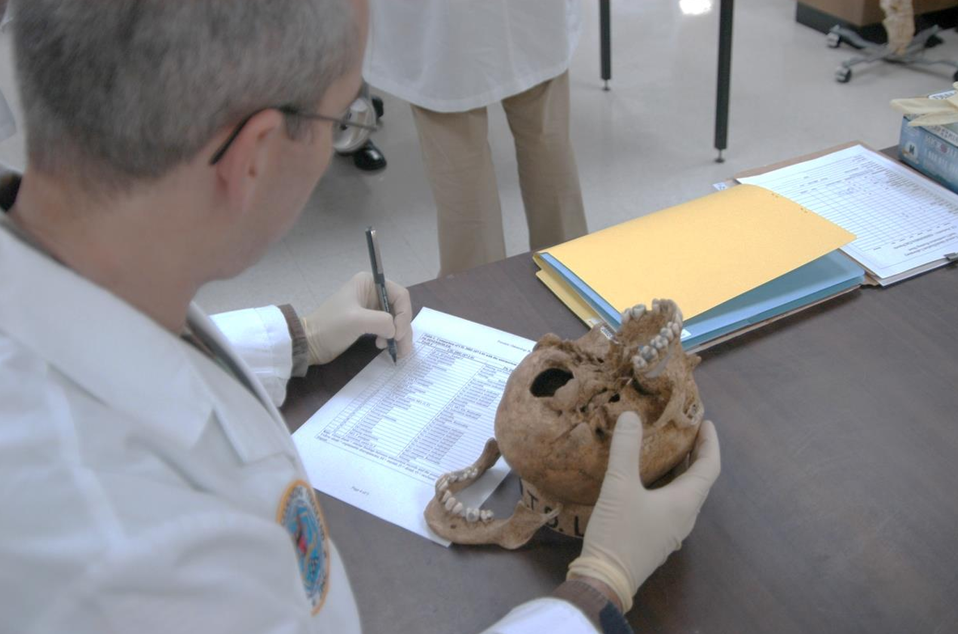
Why CoRA?

Slide 18
Why CoRA?
We need standardization, organization, and cooperation!

Slide 19
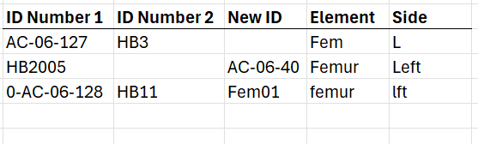
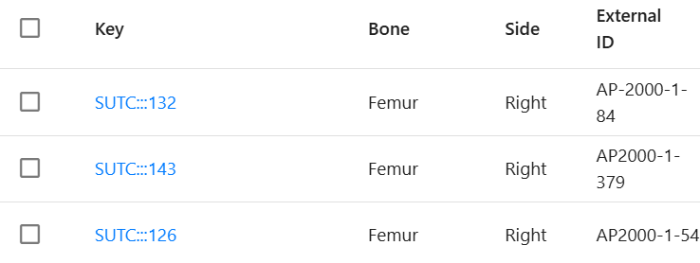
Why CoRA?
Old Methods
New Methods

Slide 20
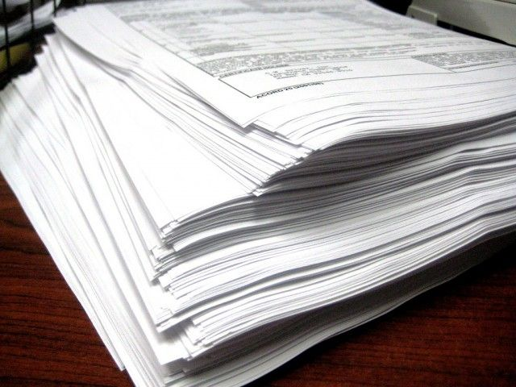
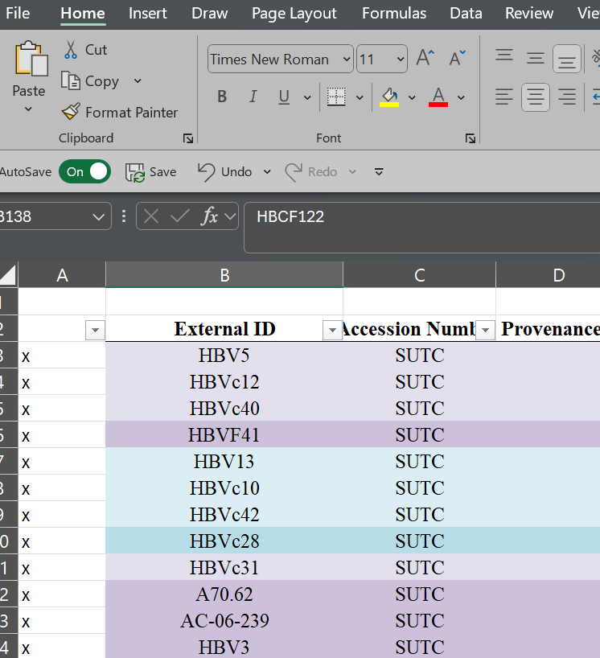
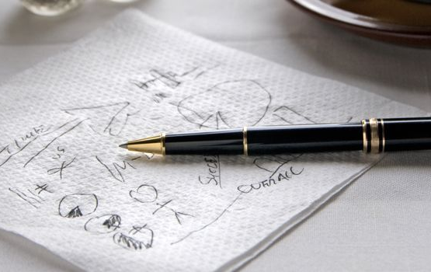
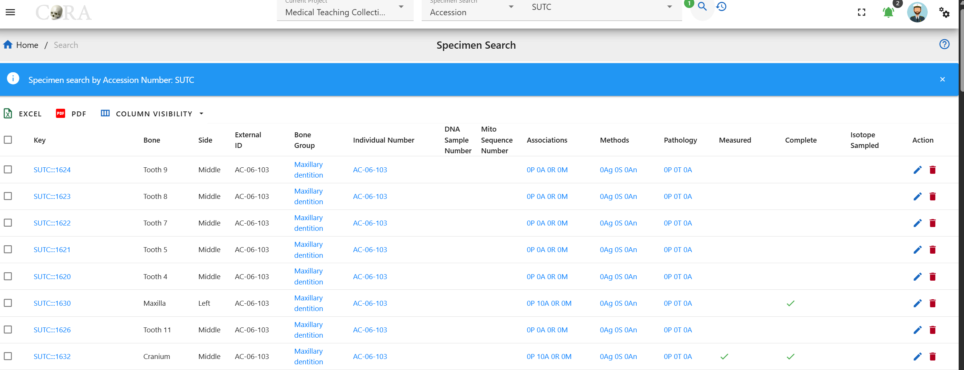
Why CoRA?
Old Methods
New Methods

Slide 21
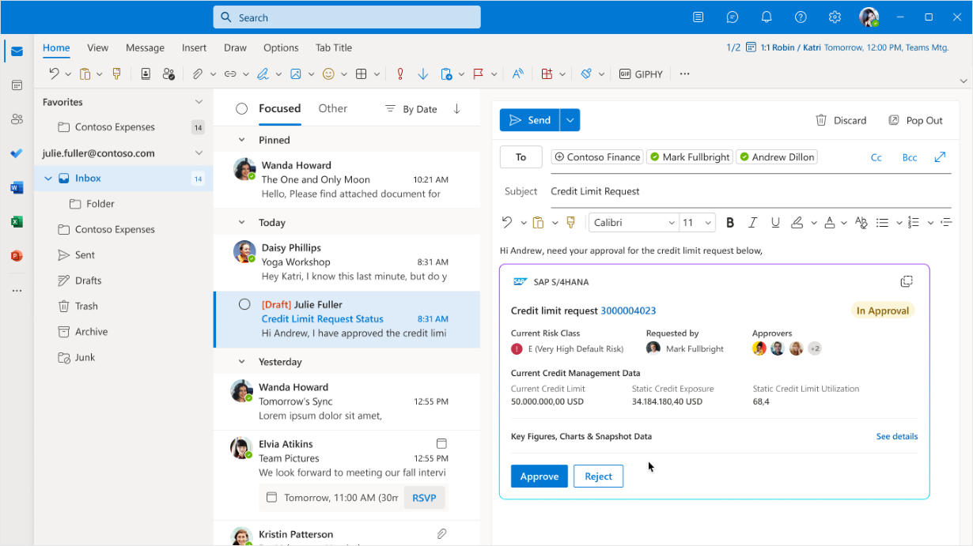

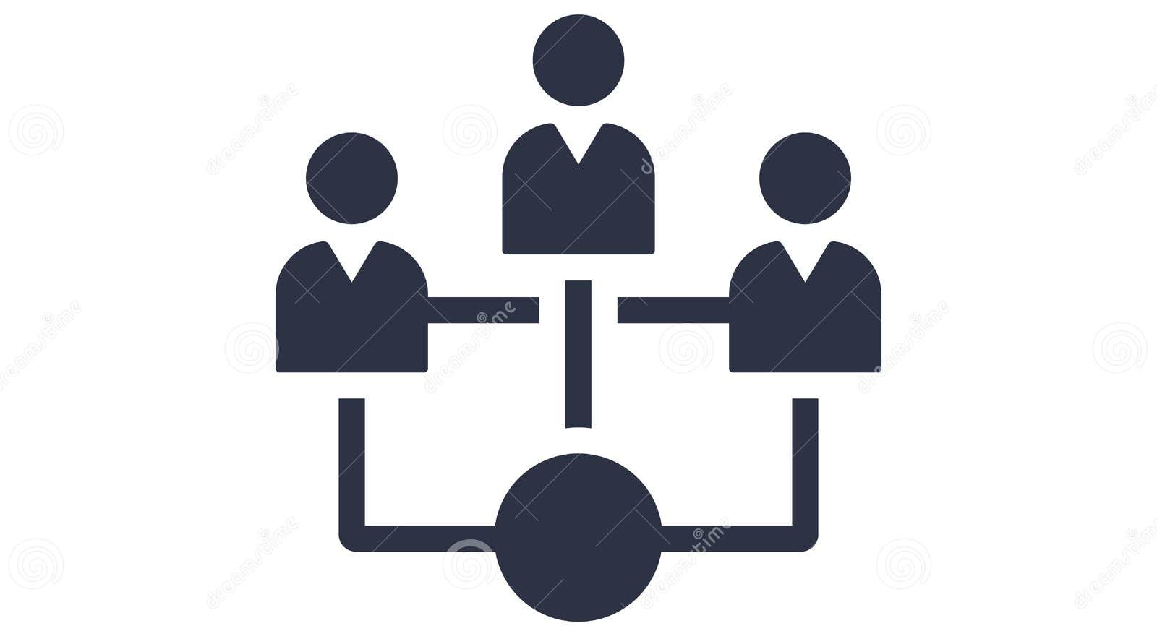
Why CoRA?
Old Methods
New Methods

Slide 22
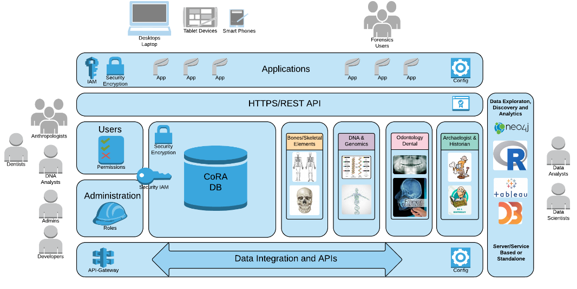

Slide 23
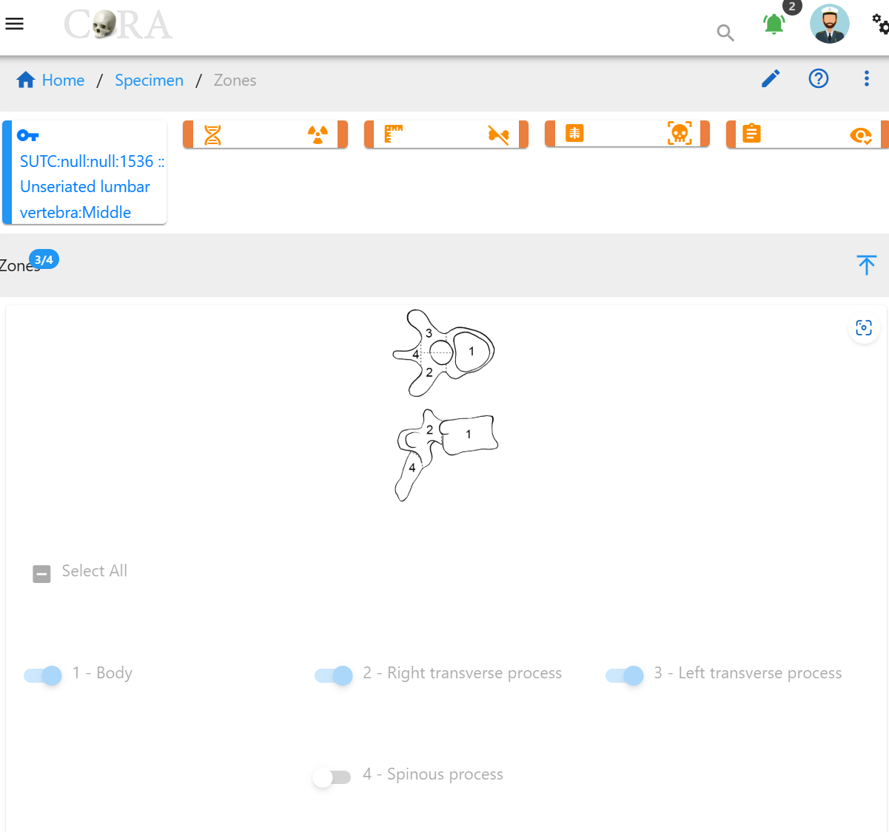
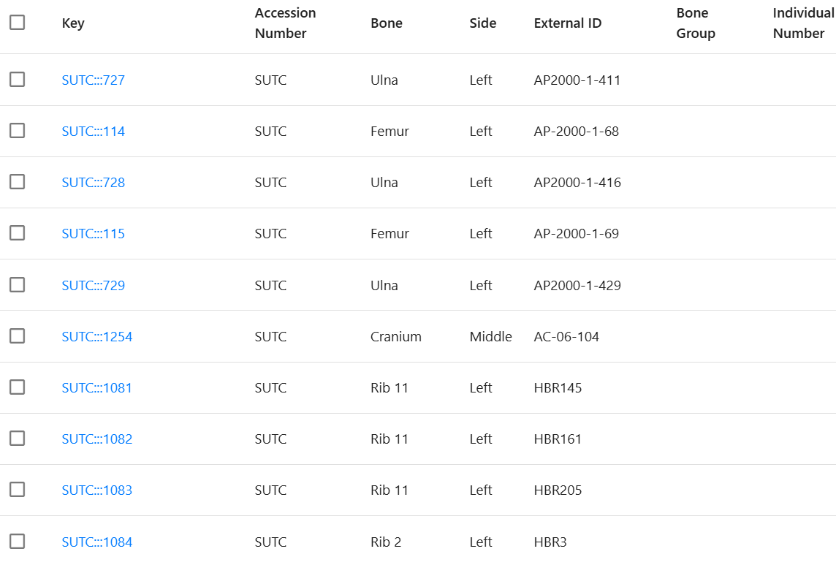
Methods
1. Basic Inventory
2. Completeness

Slide 24
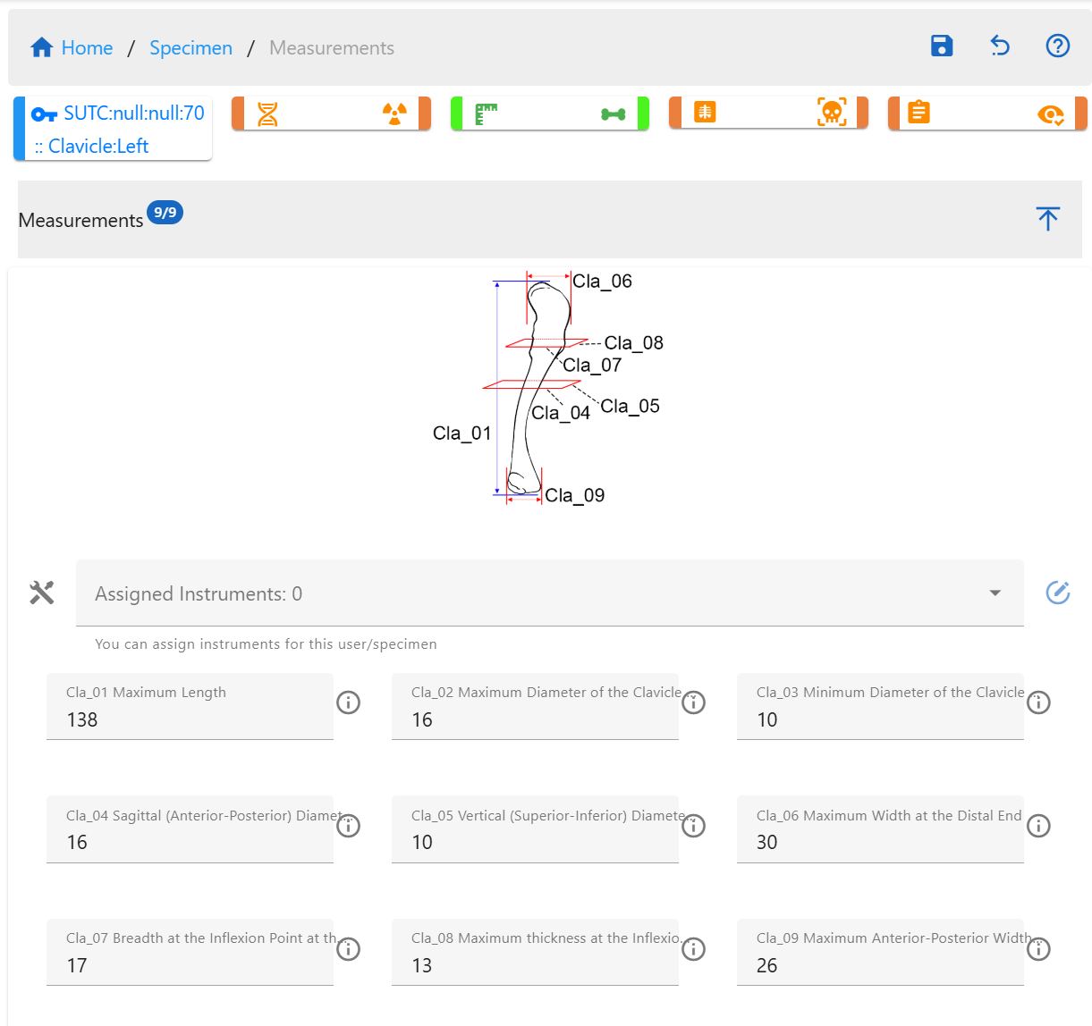
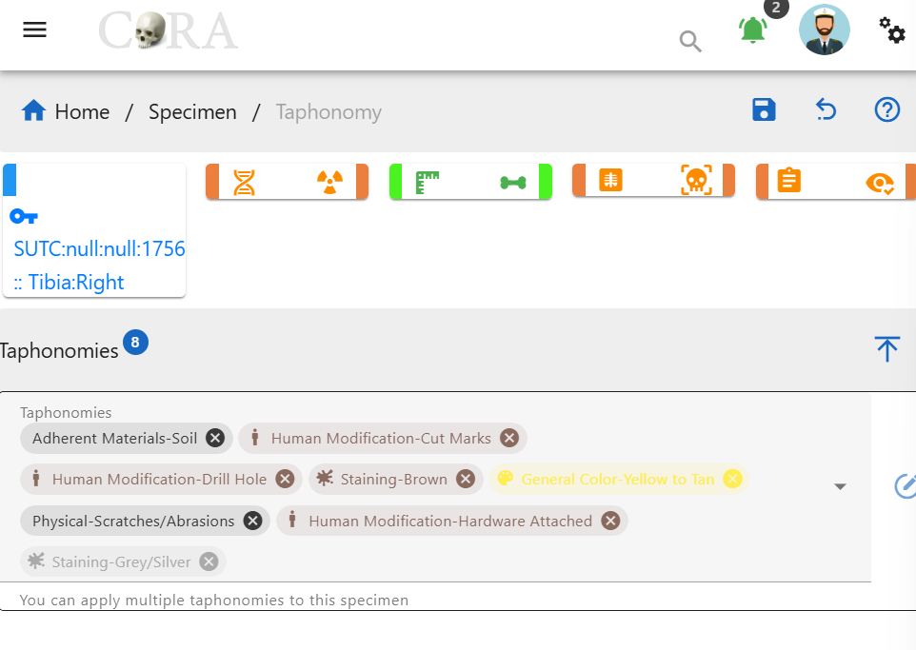
Methods
3. Measurements
4. Taphonomy

Slide 25
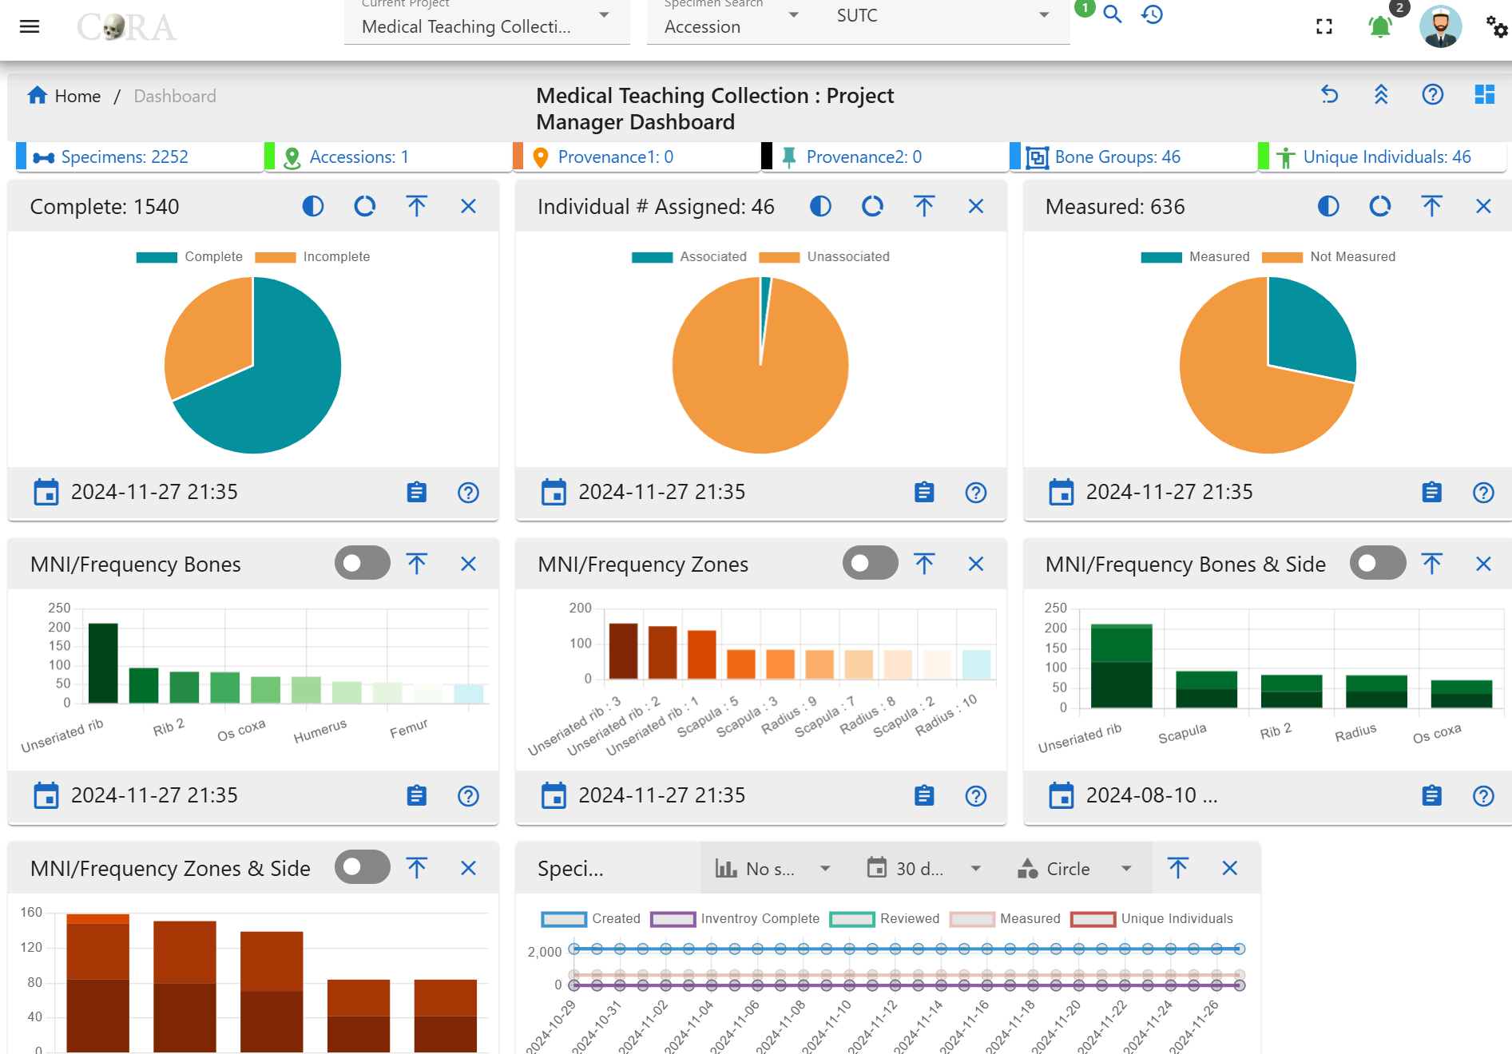
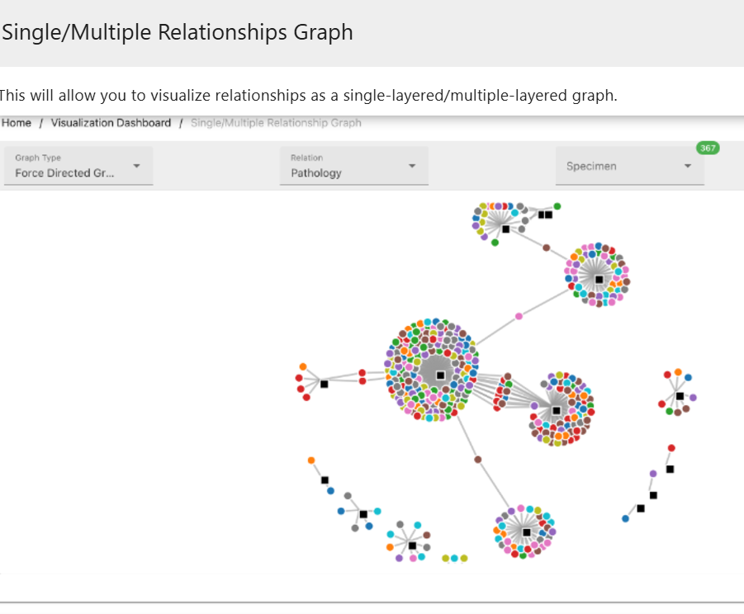
Methods
5. Data Visualization

Slide 26

Results

Slide 27
Overall Inventory
2252 individual specimens recorded (excluding hands/feet)
Over two-thirds of the specimens were complete
Most common elements: Ribs 3-10 > Scapula > Rib 2

Slide 28
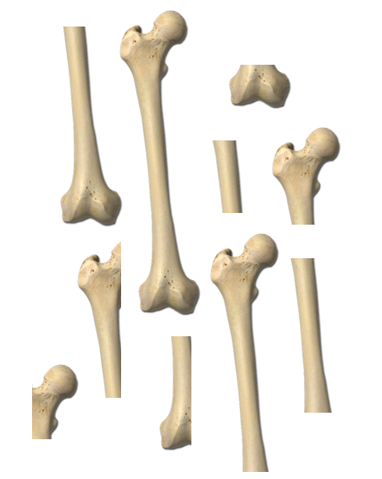
Minimum Number of Individuals – Traditional vs. Zonation MNI
Traditional MNI =

Slide 29
Minimum Number of Individuals – Traditional vs. Zonation MNI
Traditional MNI = 10

Slide 30
Minimum Number of Individuals – Traditional vs. Zonation MNI
Traditional MNI = 10
Zonation MNI =
vs.

Slide 31
Minimum Number of Individuals – Traditional vs. Zonation MNI
Traditional MNI = 10
Zonation MNI = 4
vs.

Slide 32
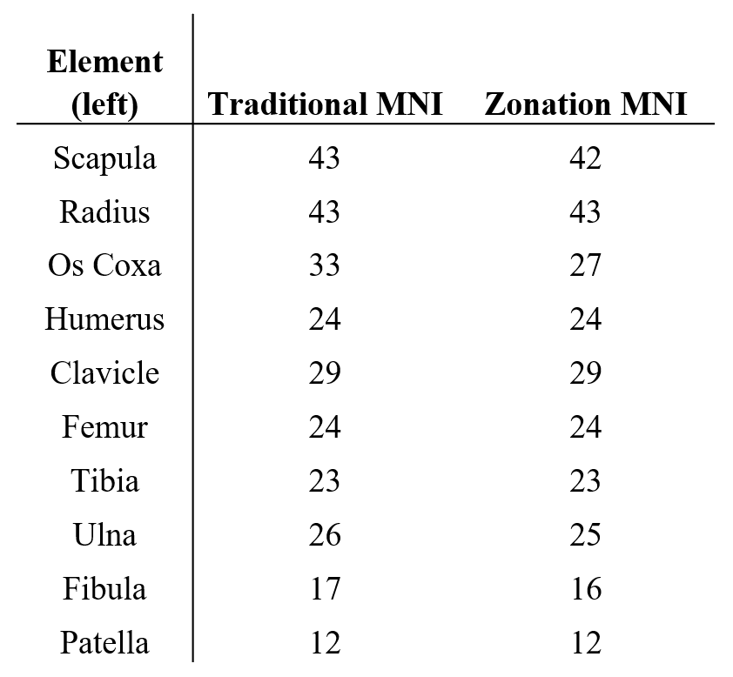
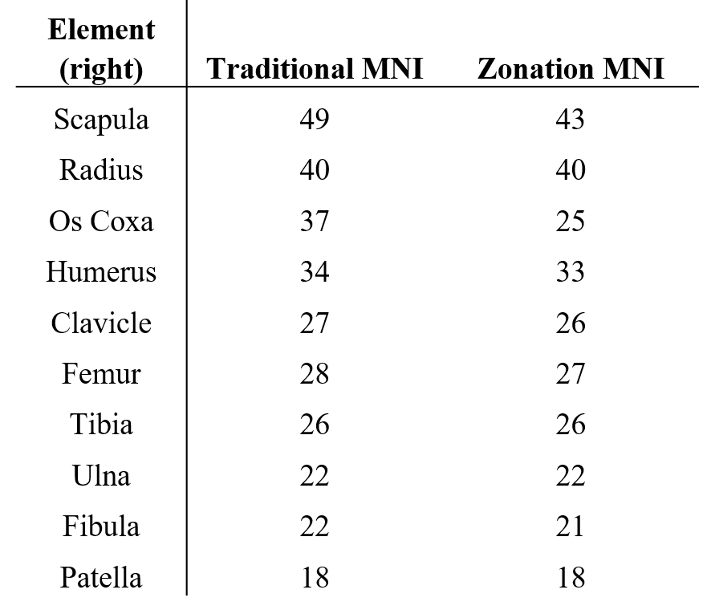
Traditional vs. Zonation MNI

Slide 33
Traditional vs. Zonation MNI

Slide 34
Traditional vs. Zonation MNI

Slide 35
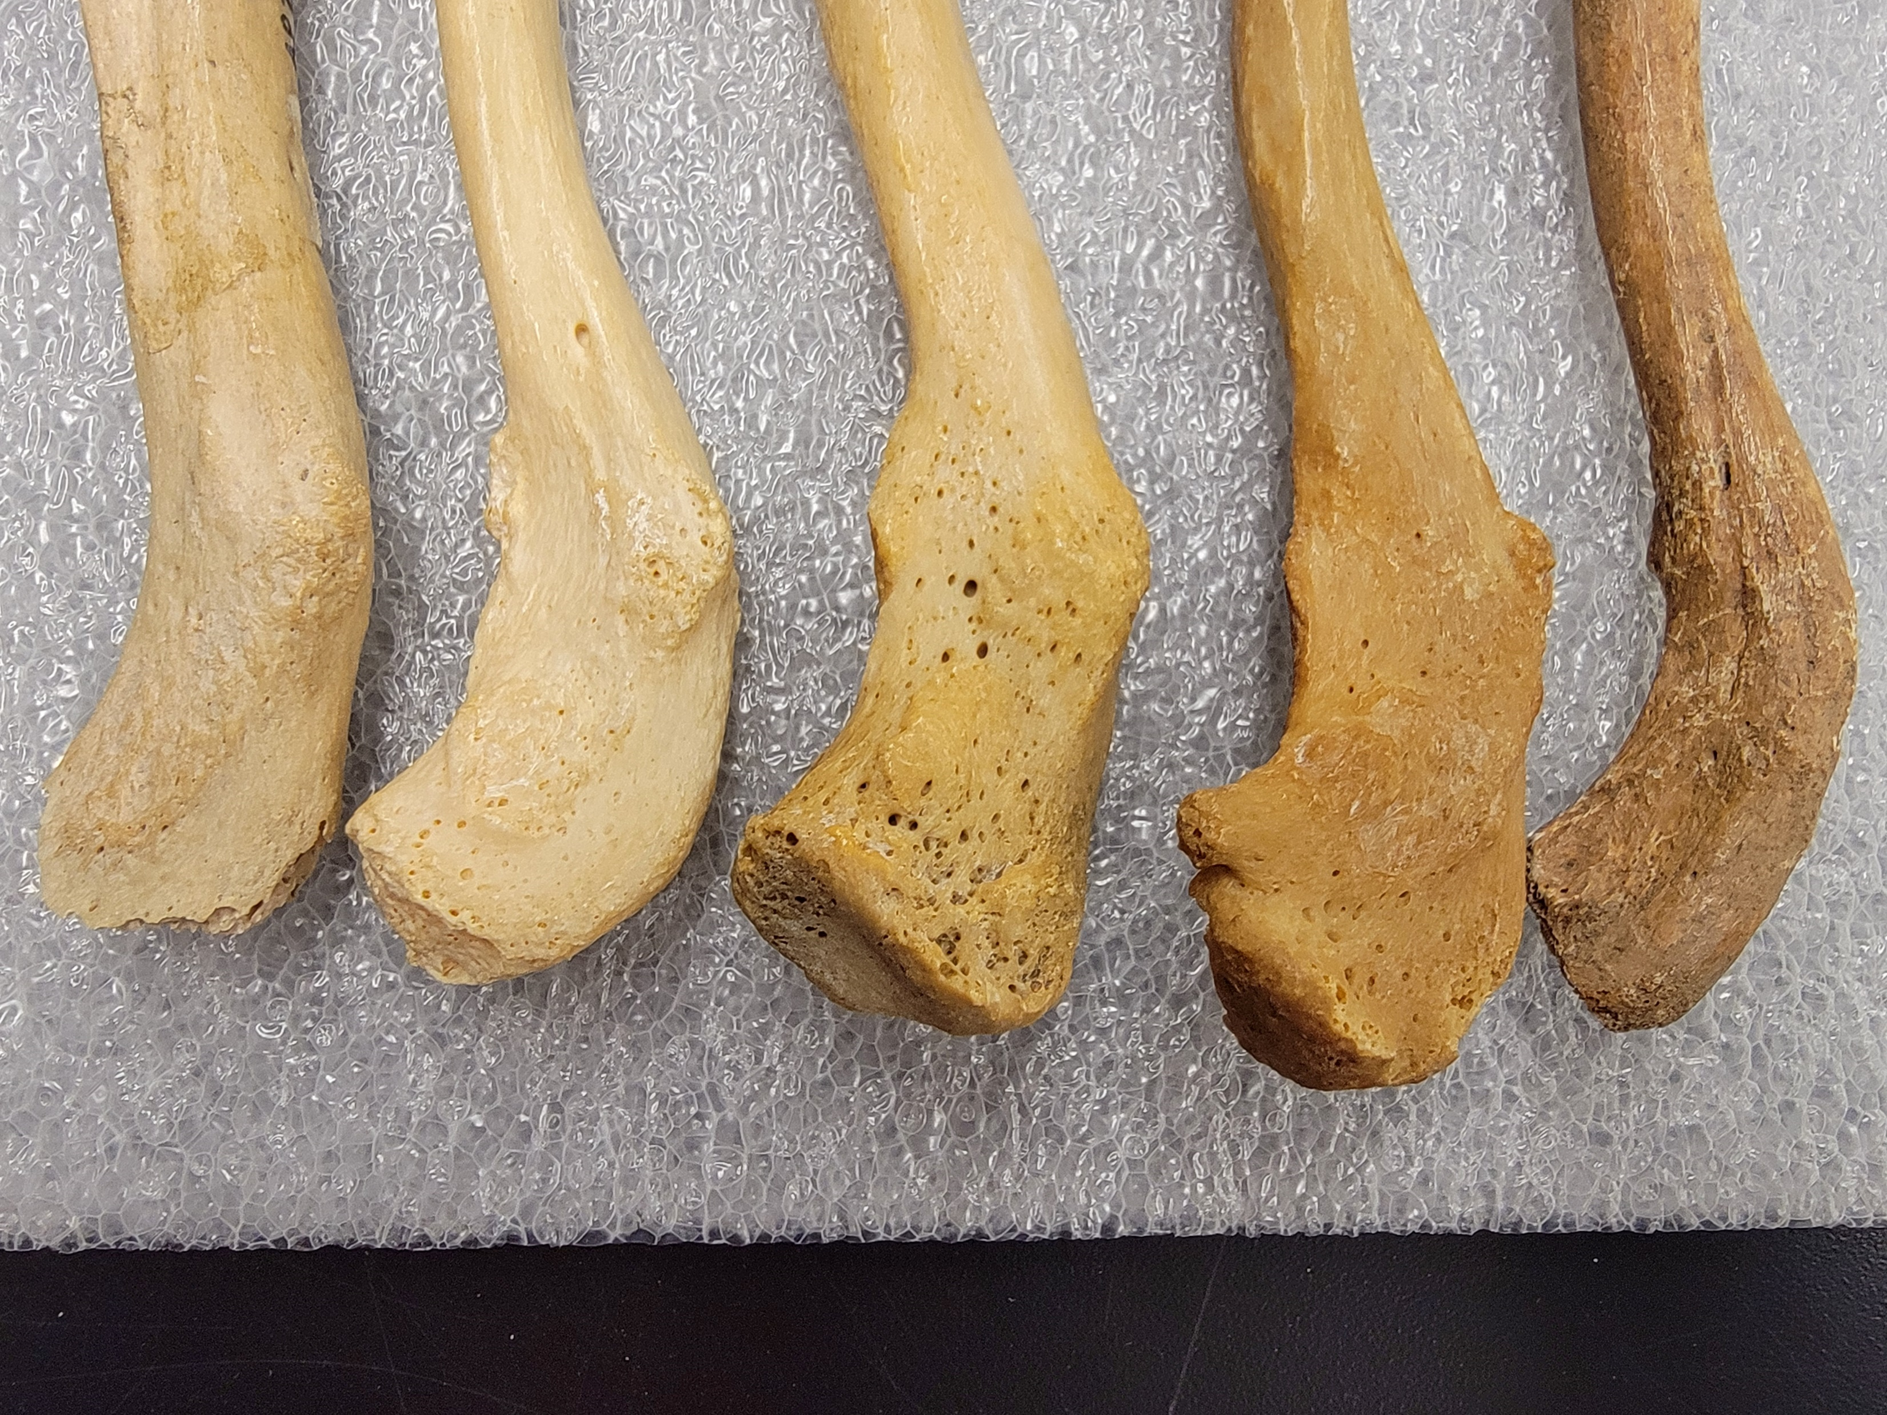
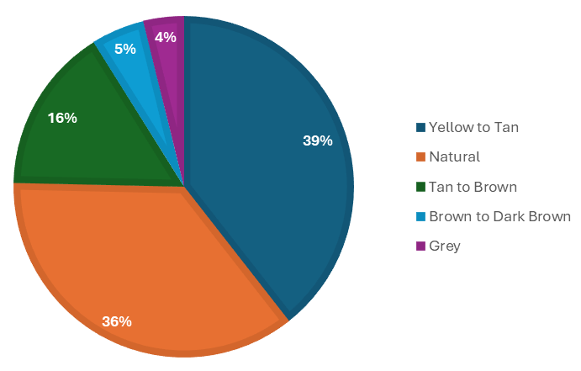
Taphonomy – General Color
Grey
Natural
Yellow/ Tan
Tan/ Brown
Brown/
Dark Brown

Slide 36
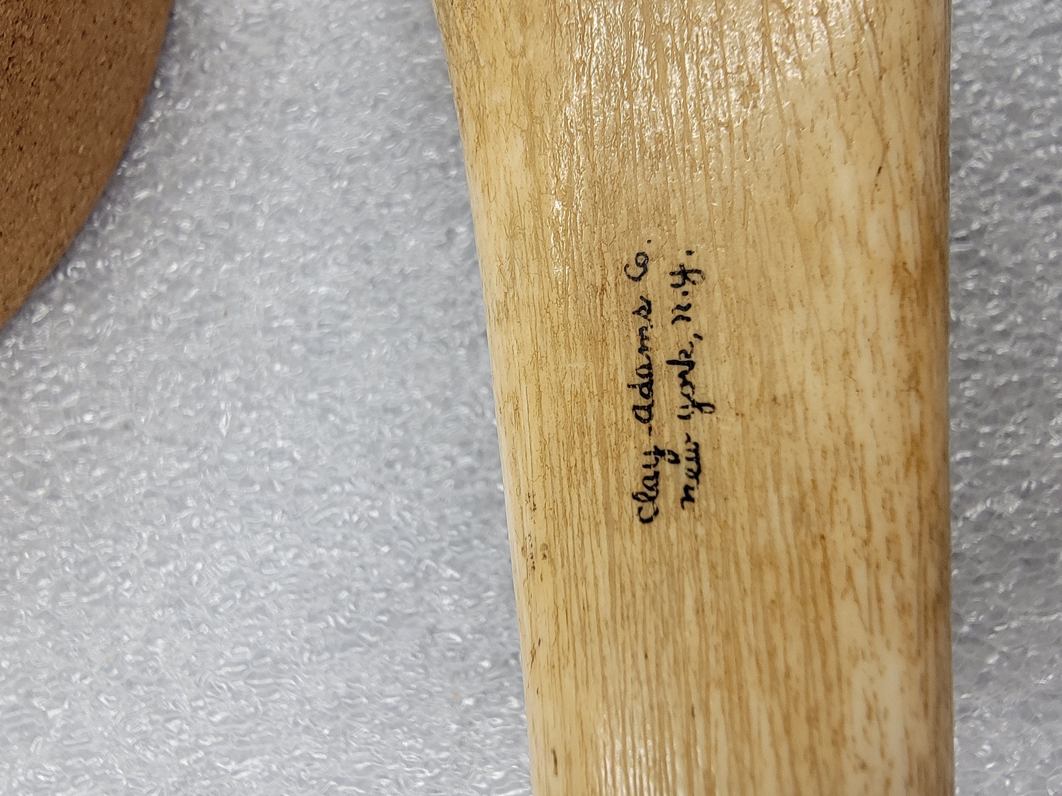
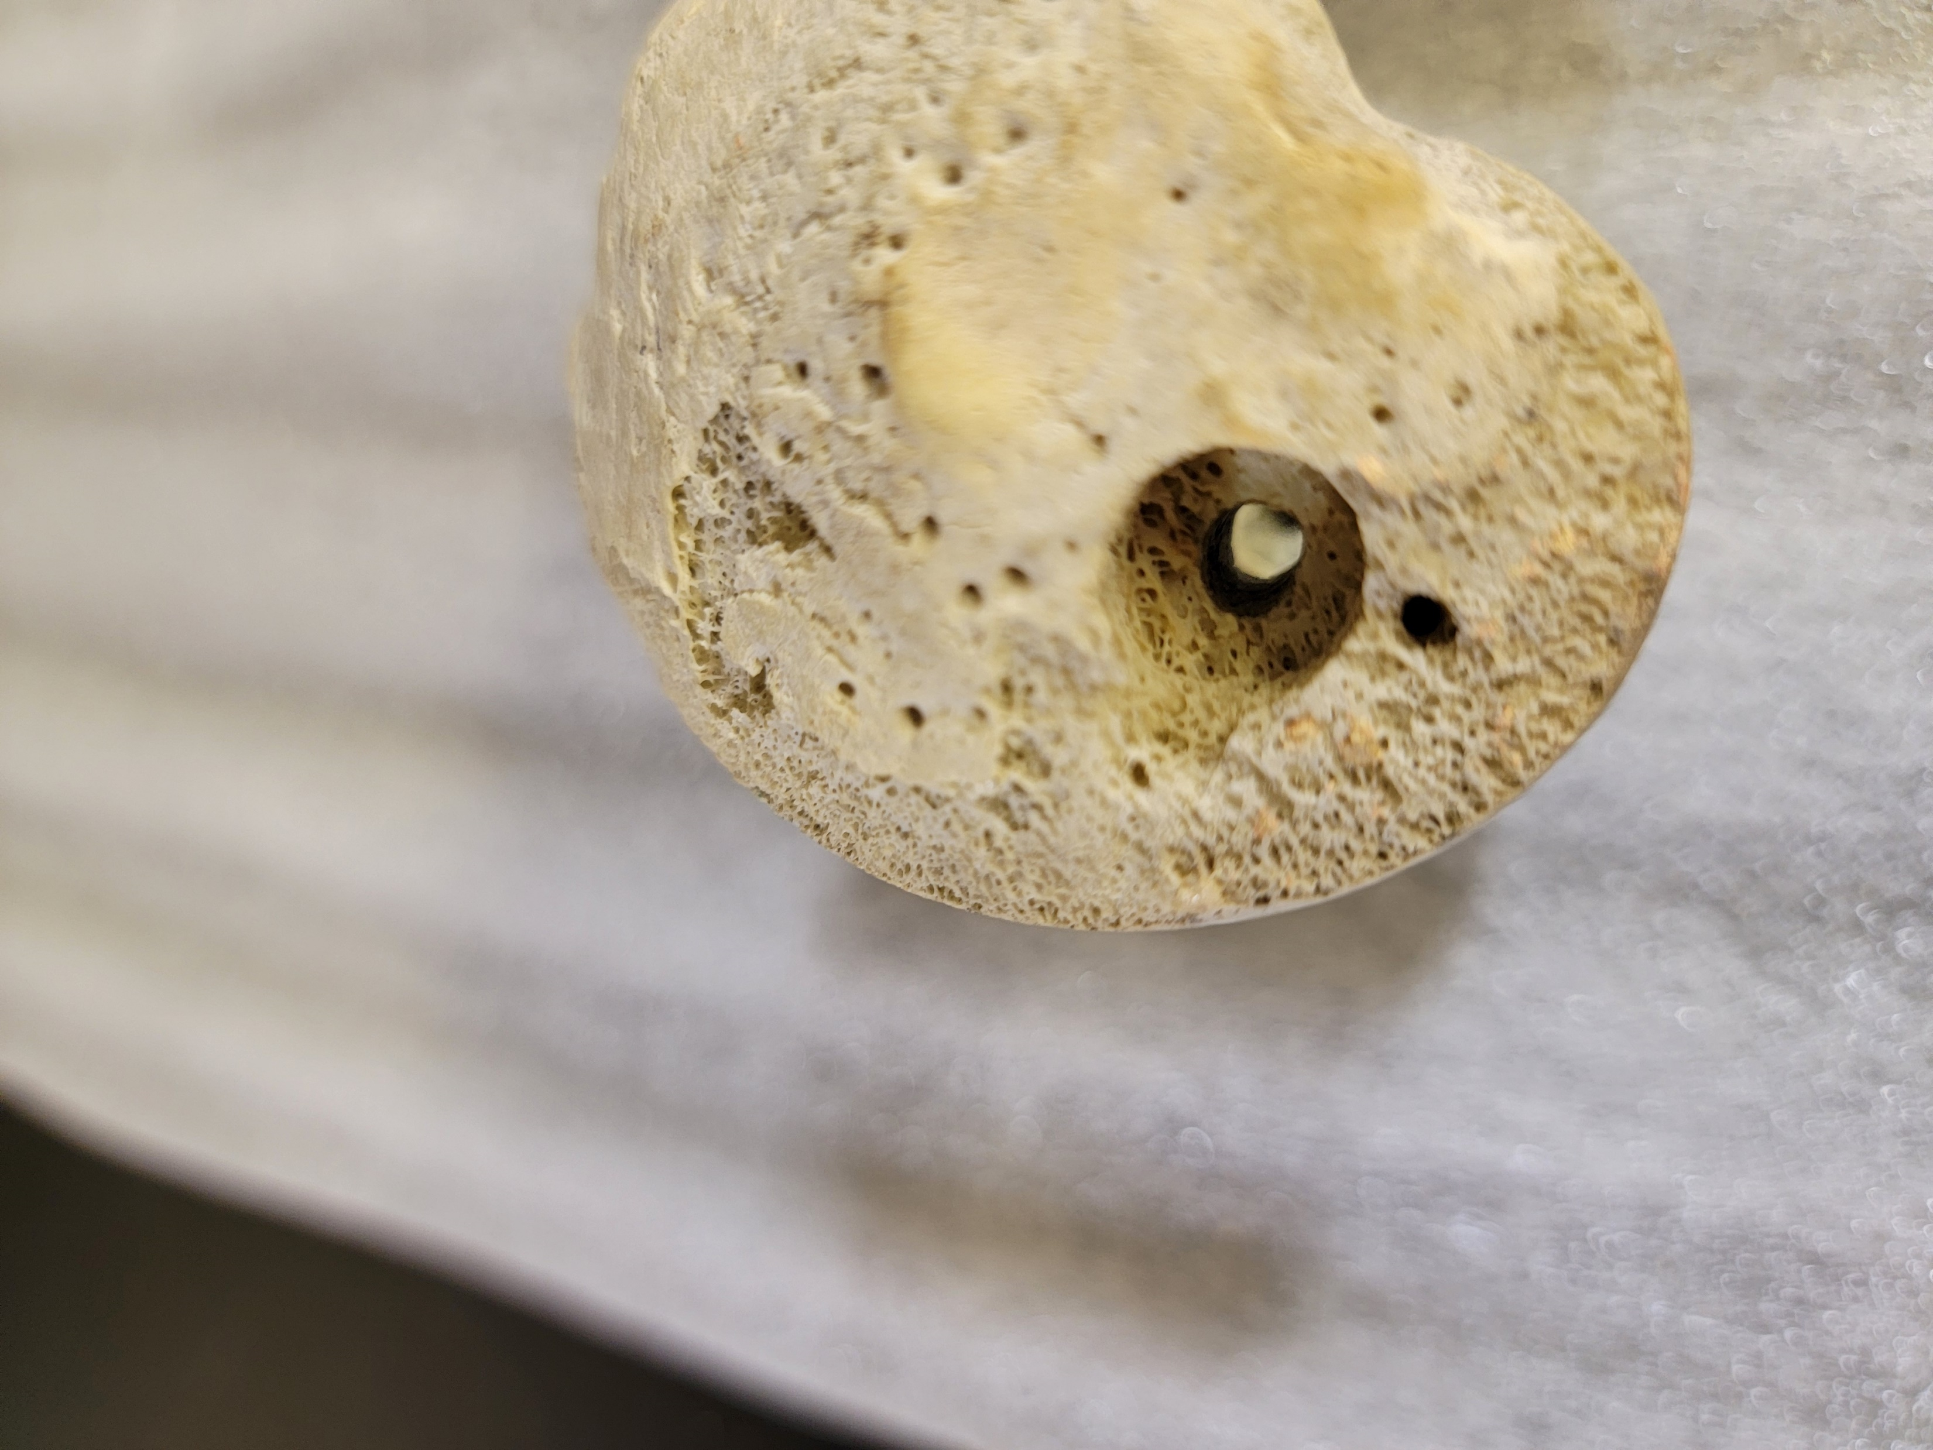
Taphonomy – Human Modification
Writing
Drill Hole

Slide 37
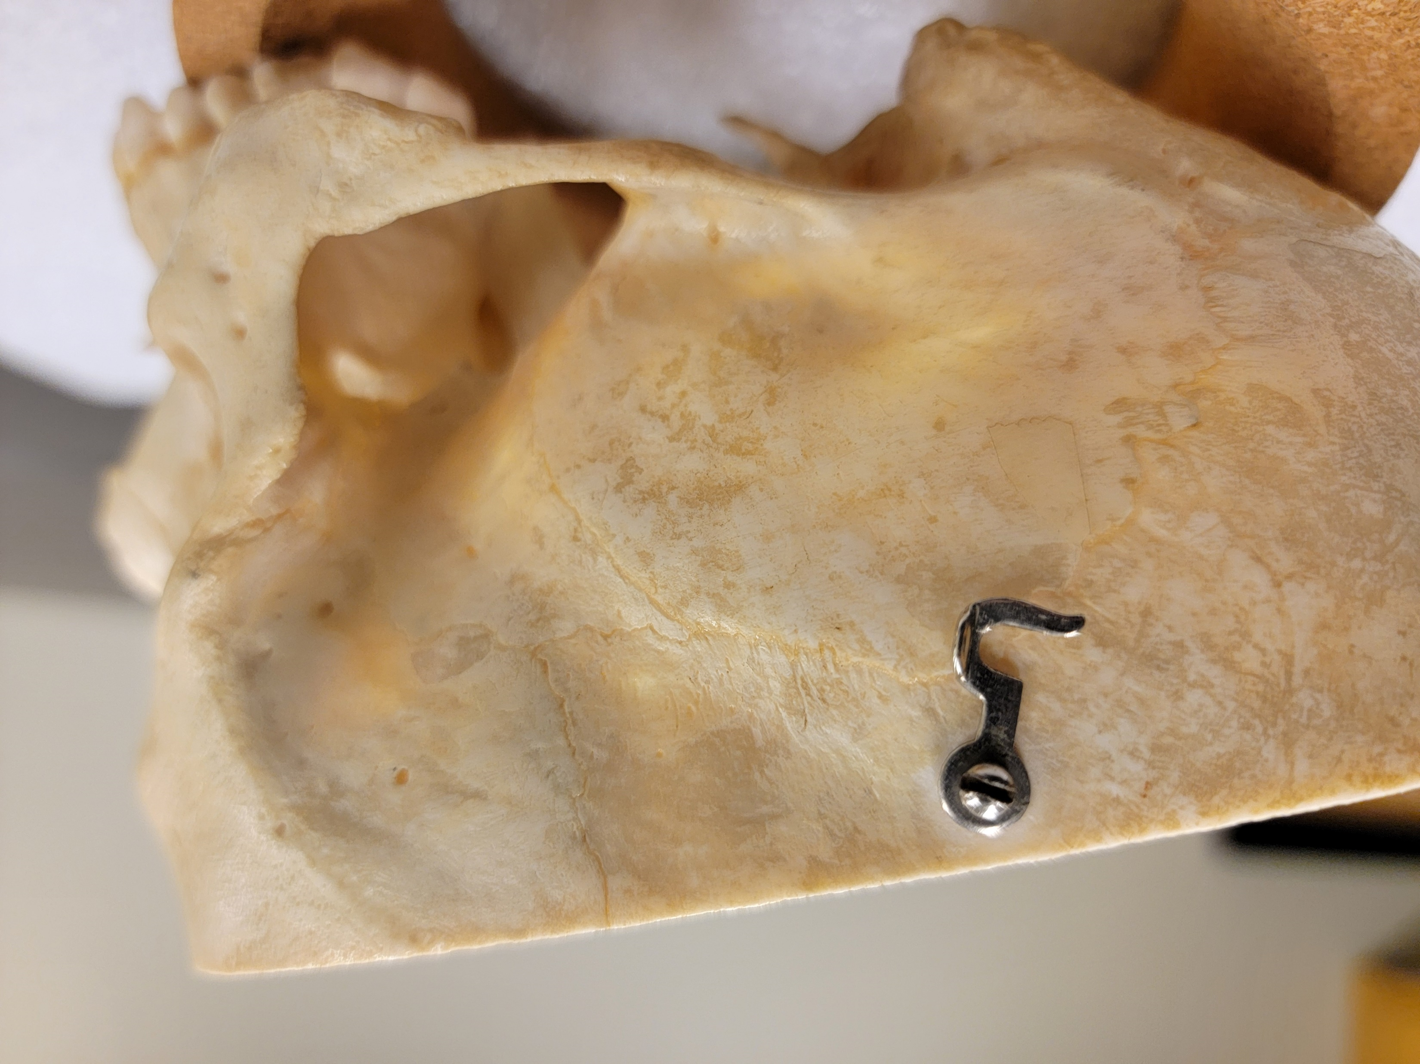
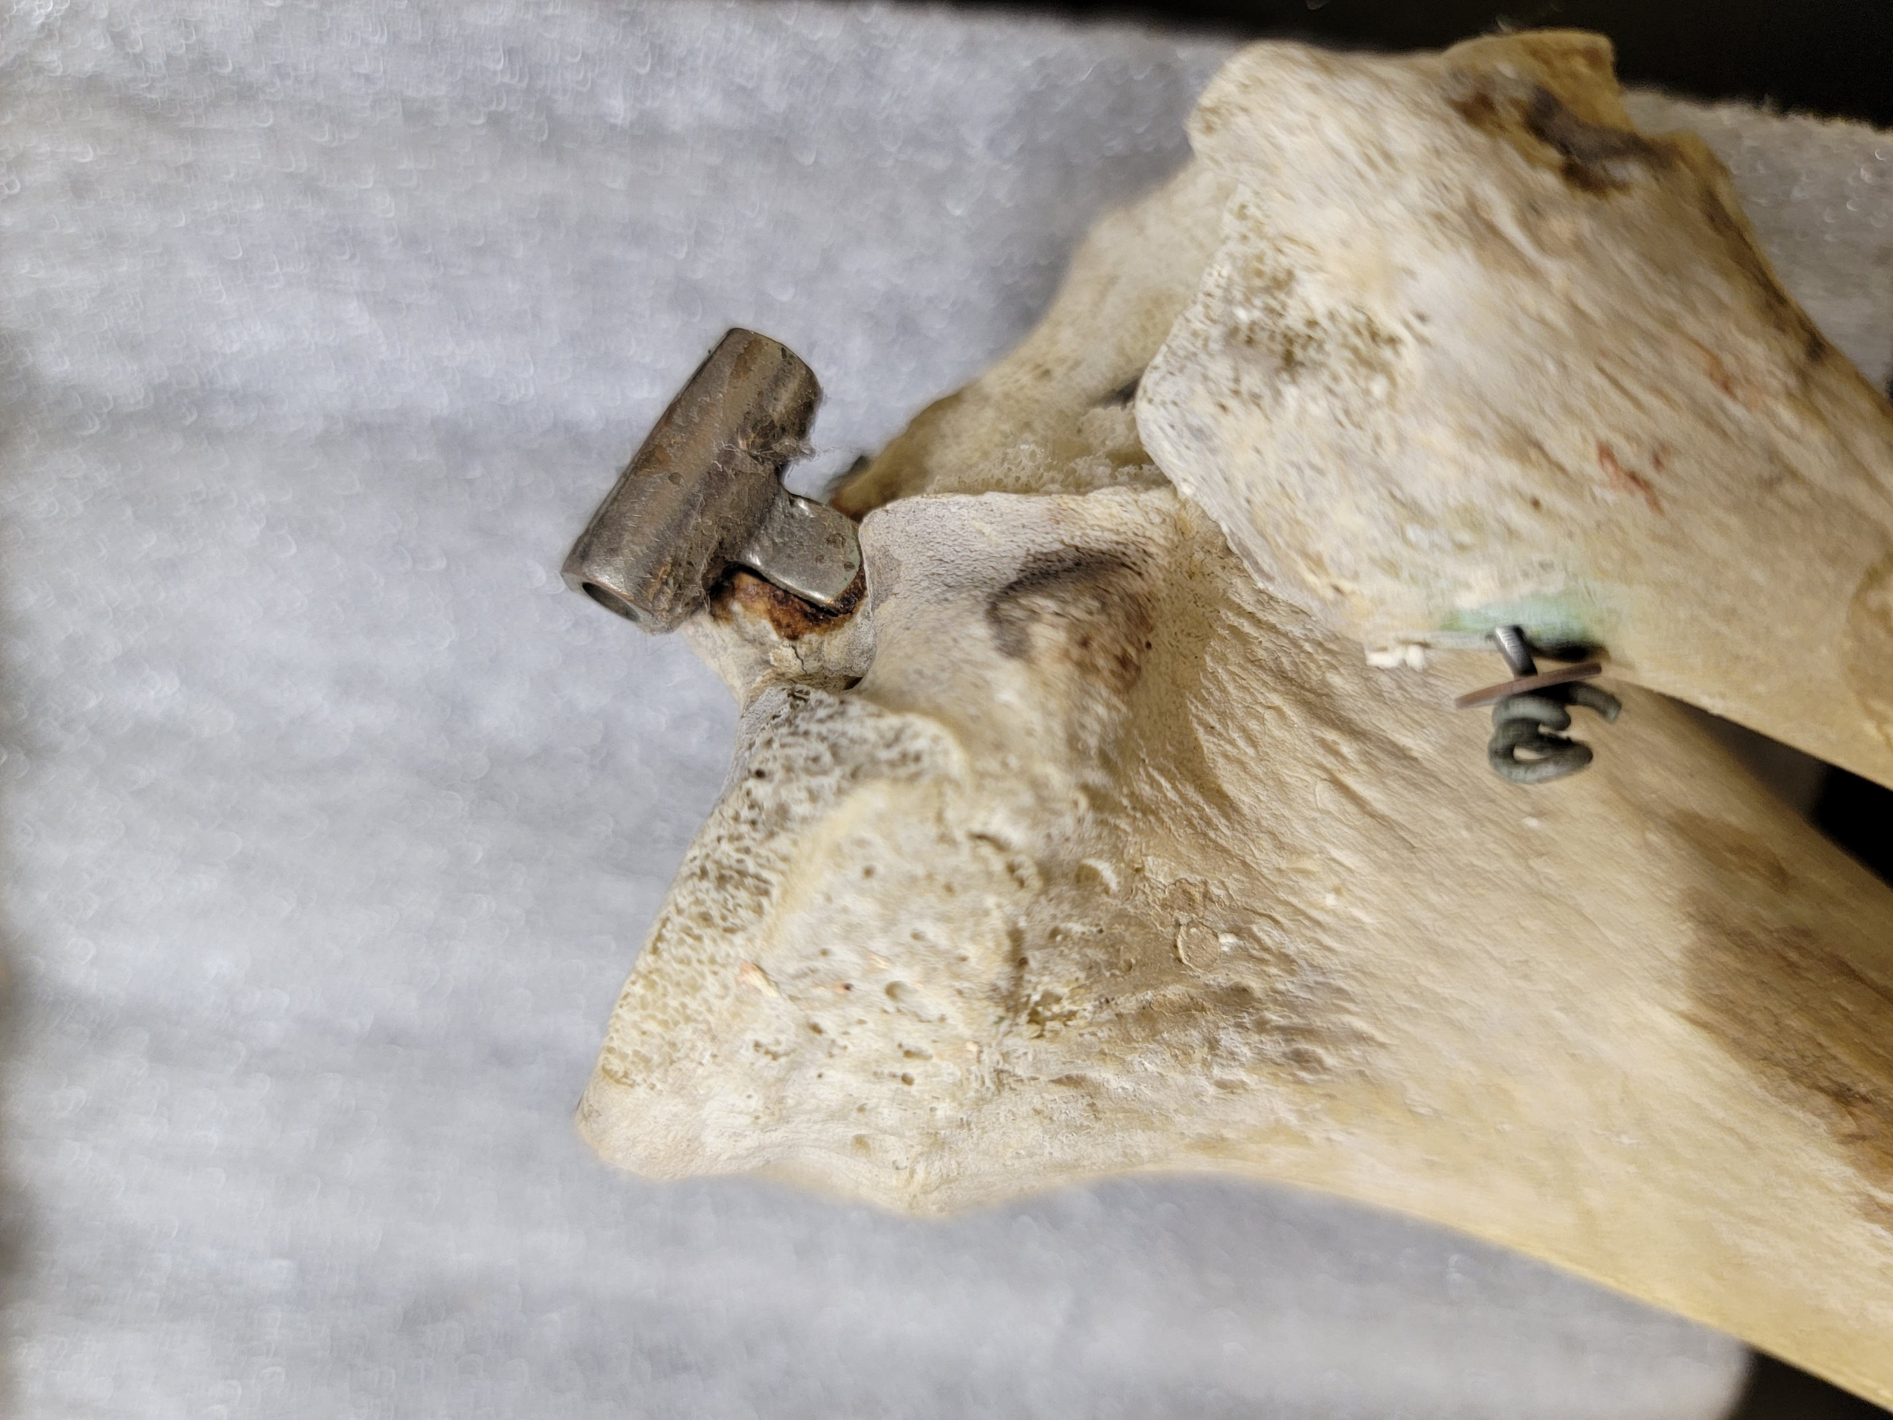
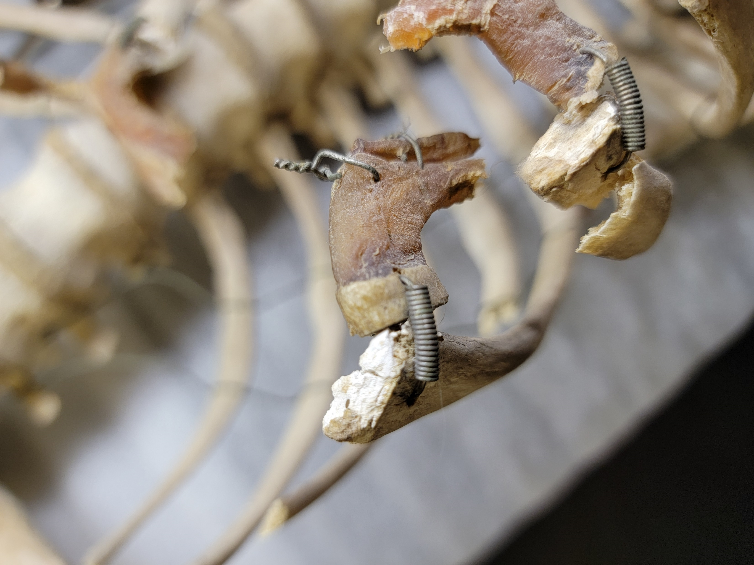
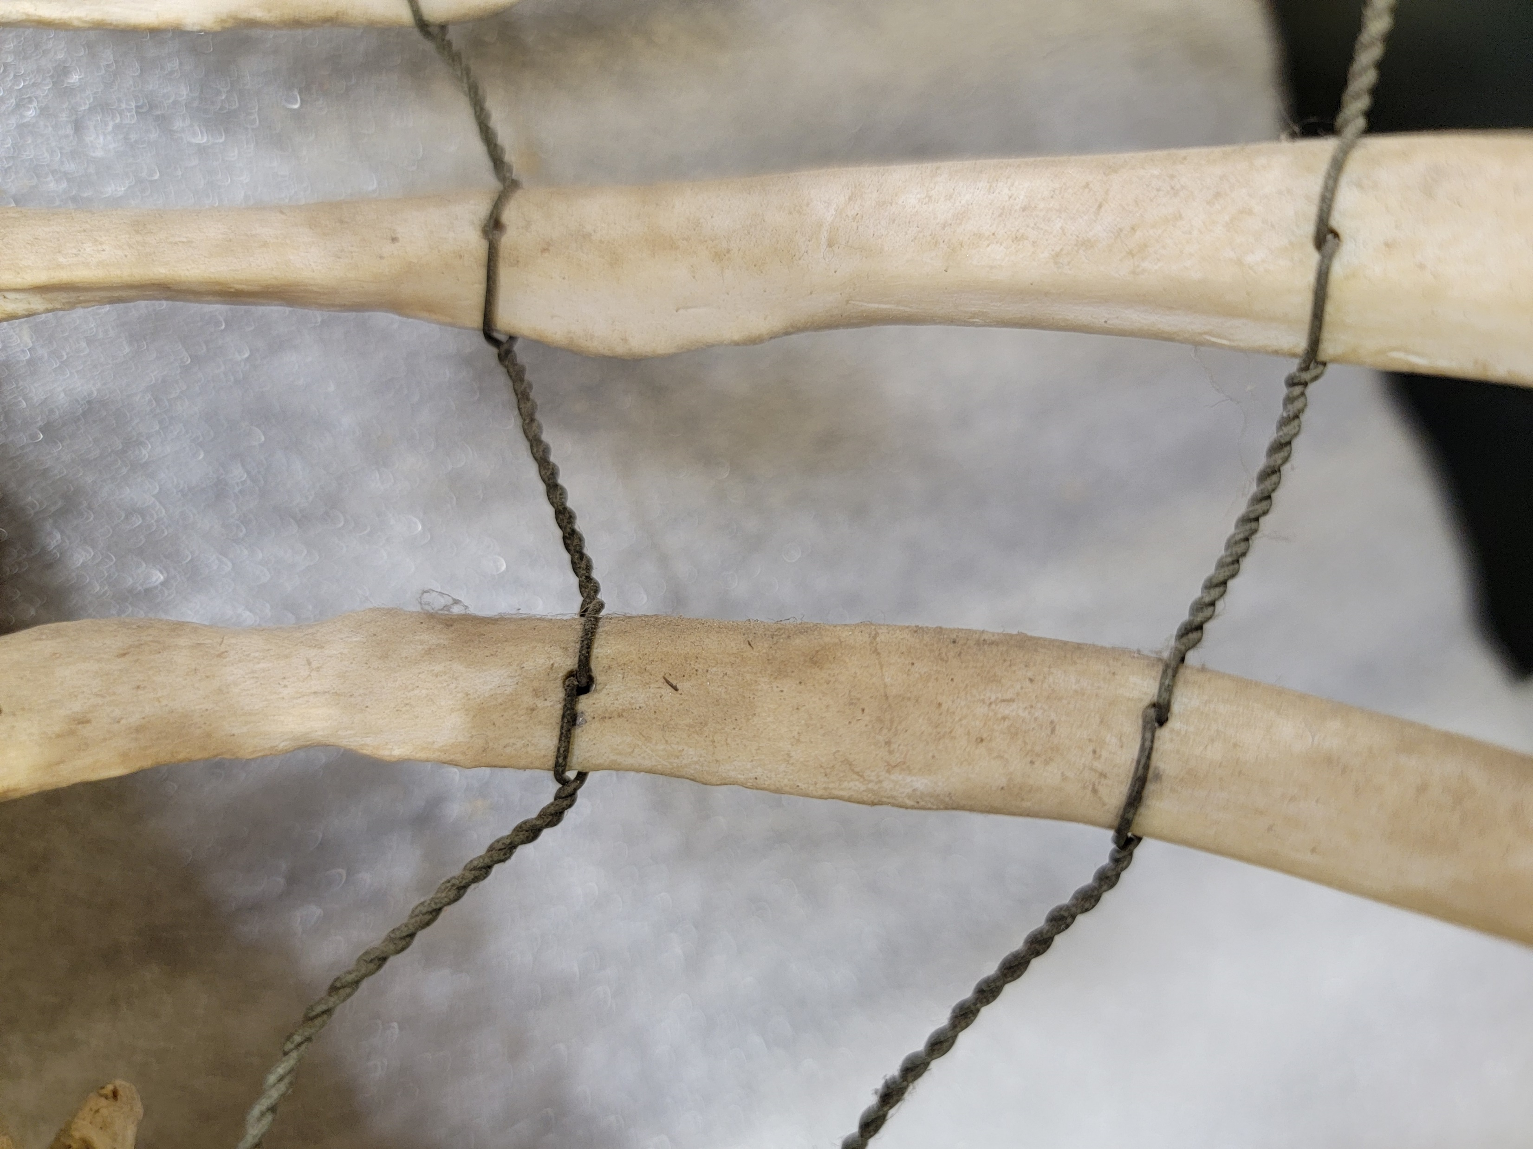
Taphonomy – Human Modification
Hardware Attached

Slide 38
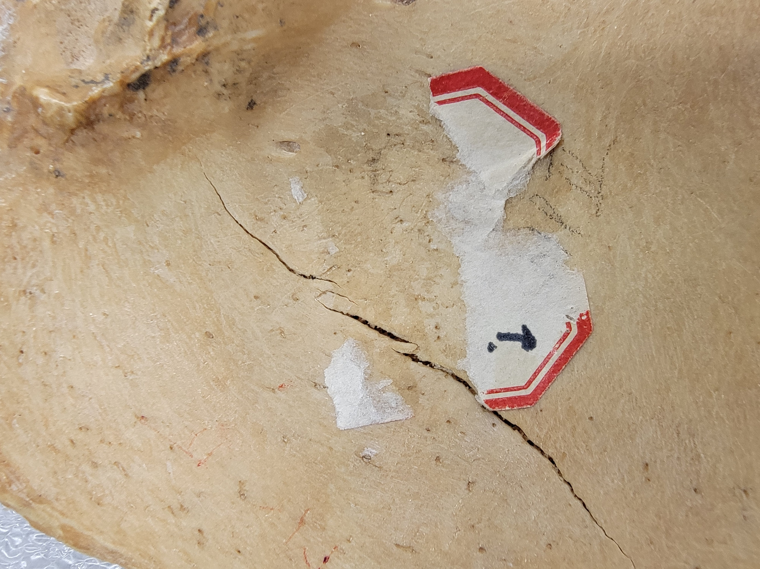
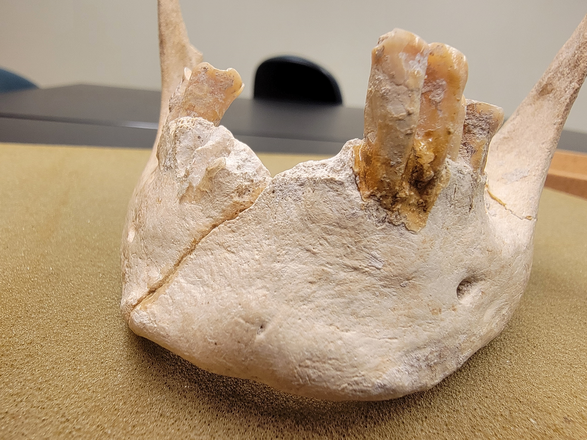
Taphonomy – Human Modification
Adherent Material
Reconstructive Material

Slide 39
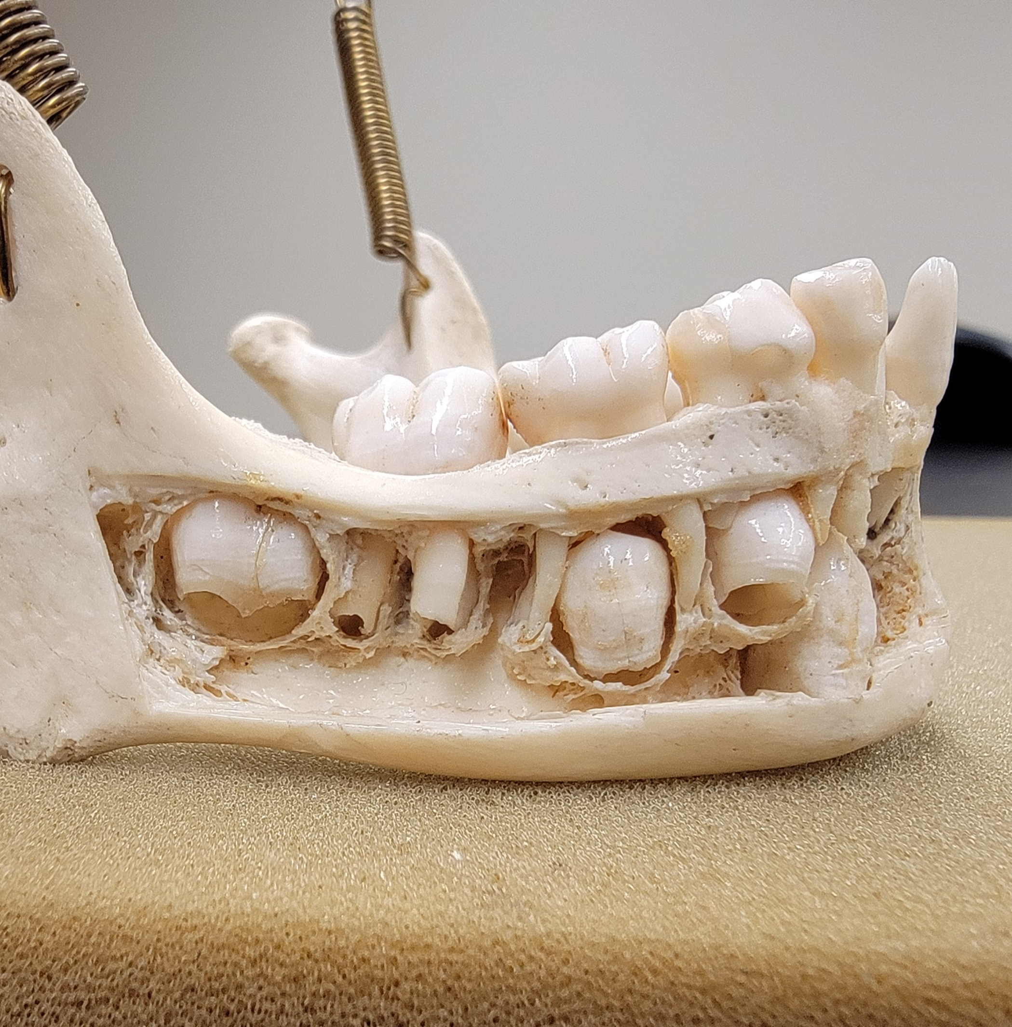
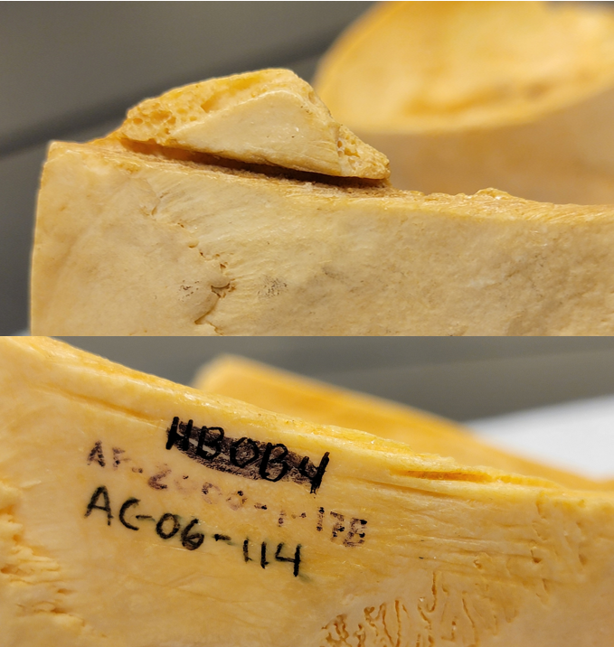
Taphonomy – Human Modification
Bone Section Removed
Cut Marks

Slide 40
Project Goals… Met!
1. Evidence for medical/ anatomical teaching collection?
Taphonomic traits consistent with other known skeletal teaching collections (i.e., sectioning of the skull, attached hardware, etc.)
2. Minimum number of individuals?
Traditional MNI = 49 (right scapula)
Zonation MNI = 43 ( right scapula/ left radius)
3. CoRA as a valuable tool for documenting/ analyzing this collection?
Archival Records of dissection/ anatomy courses at SU
Increased organization and ease of inventorying/ documentation of specimens
Data Analysis and visualization features (i.e., project dashboard, MNI charts, single/multiple relationships graphs)

Slide 41
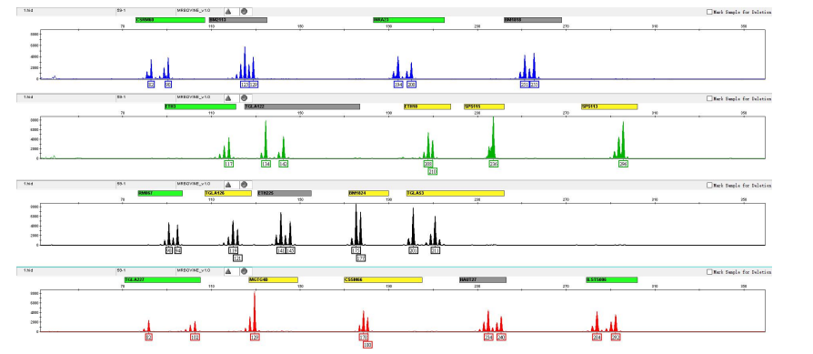
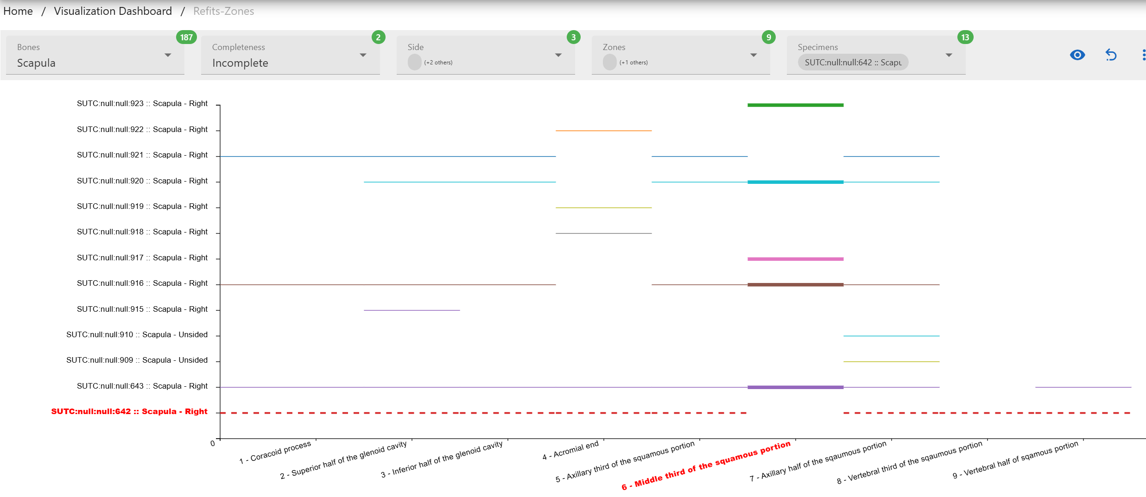
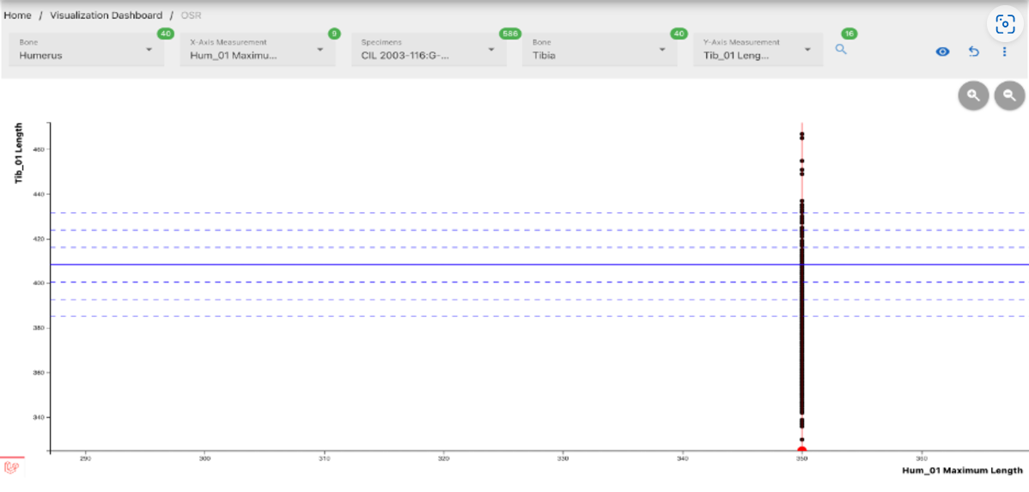
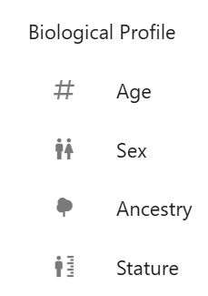
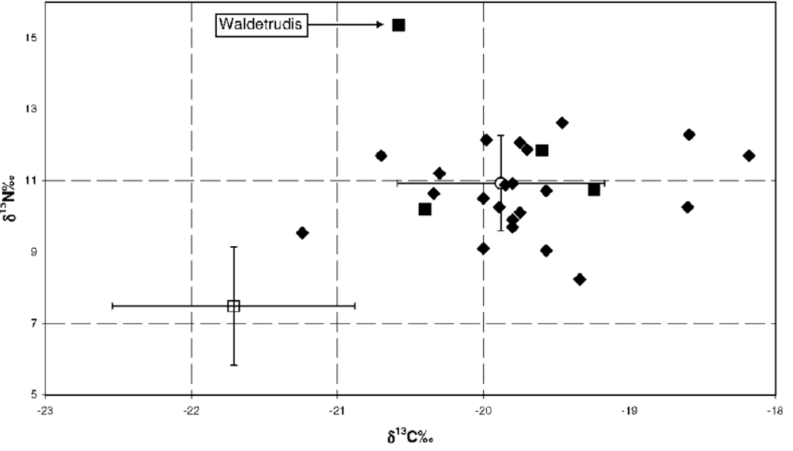
Future Directions
Inventory remaining specimens
Resolution of commingled remains/ identification of individuals using CoRA
Alternative quantification methods
Refits
Osteometric Sorting Regression
Biological Profile
DNA/ Stable Isotope Analysis

Slide 42

Questions?

Slide 43
References
1. Sappol M. A Traffic Of Dead Bodies: Anatomy and Embodied Social Identity in Ninteenth-Century America. 2002.
2. Wright KW. Foundations Well and Truly Laid: A History Leading to the Formation of the State University of New York Health Center at Syracuse. Alumni Association of the SUNY Health Center at Syracuse; 1994.
3. Pawaskar S, Streetman E, C. LeGarde, Jensen N, Stuti Raut, Damann F, et al. spawaskar-cora/cora-docs: v2.1.0 Open Community Release [Internet]. Zenodo; 2021 [cited 2024 Oct 29]. Available from: https://zenodo.org/record/5694496

Slide 44
Photos
My photo
https://www.laphamsquarterly.org/roundtable/body-snatchers-old-new-york
https://www.villagepreservation.org/2018/05/17/elizabeth-blackwells-nyc-the-historic-sites-where-americas-first-female-doctor-made-her-mark/
https://www.cardcow.com/461826/birds-eye-view-auburn-prison-new-york/
https://www.civilwarmed.org/bodysnatching/
https://www.buzzfeednews.com/article/gabrielsanchez/pictures-history-of-new-york-city-hospitals-coronavirus
https://www.sciencephoto.com/media/150111/view/american-university-of-beirut
https://commonwealthtimes.org/2022/01/28/researchers-at-mcv-to-conduct-dna-analysis-on-19th-human-remains-found-on-campus/
https://www.shorpy.com/node/644
https://www.nationalww2museum.org/war/topics/defense-powmia-accounting-agency
https://universitypositions.eu/universities/europe/university-of-milan?
Dr. Sachin Pawaskar
Dr. Sachin Pawaskar
My Photo
https://cora-analytics.coracore.org/
https://i.pinimg.com/736x/3e/68/f7/3e68f786fe175b1f77b2abe34c6ba667--in-the-classroom-paper-industry.jpg
My Photo
https://www.dreamstime.com/royalty-free-stock-images-scribble-napkin-table-pen-image5310409
https://cora-analytics.coracore.org/
https://techcommunity.microsoft.com/blog/microsoft_365blog/adaptive-card-based-loop-components-collaborate-on-live-content-in-teams-and-out/3644272

Slide 45
Photos
21. https://www.sherpany.com/de/ressourcen/vorstandssitzungen/team-meeting-leitfaden/
22. https://www.dreamstime.com/users-interconnected-icon-white-background-simple-element-illustration-business-analytics-concept-sign-symbol-design-image141333244
23. https://docs.coracore.org/en/latest/
24. https://cora-analytics.coracore.org/
25. https://cora-analytics.coracore.org/
26. https://cora-analytics.coracore.org/
27. https://cora-analytics.coracore.org/
28. https://cora-analytics.coracore.org/
29. https://cora-analytics.coracore.org/
30. https://gdocservices.com/wp-content/uploads/2020/03/AdobeStock_123448249.jpeg
31. https://ltsa.sheridancollege.ca/apps/human-anatomy/quiz_labeling_femur.html?bgImage=
32. My Photo
33. My Photo
34. My Photo
35. My Photo
36. My Photo
37. My Photo
38. My Photo
39. My Photo
40. My Photo

Slide 46
Photos
41. My Photo
42. My Photo
43. https://cora-analytics.coracore.org/
44. https://cora-analytics.coracore.org/
45. https://cora-analytics.coracore.org/
46. https://en.microread.com/product/productDetail-25-118.html
47. https://www.researchgate.net/figure/Stable-isotope-data-from-skeletal-material-from-Belgian-saints-historically-attested_fig2_277154932

